Slide 1
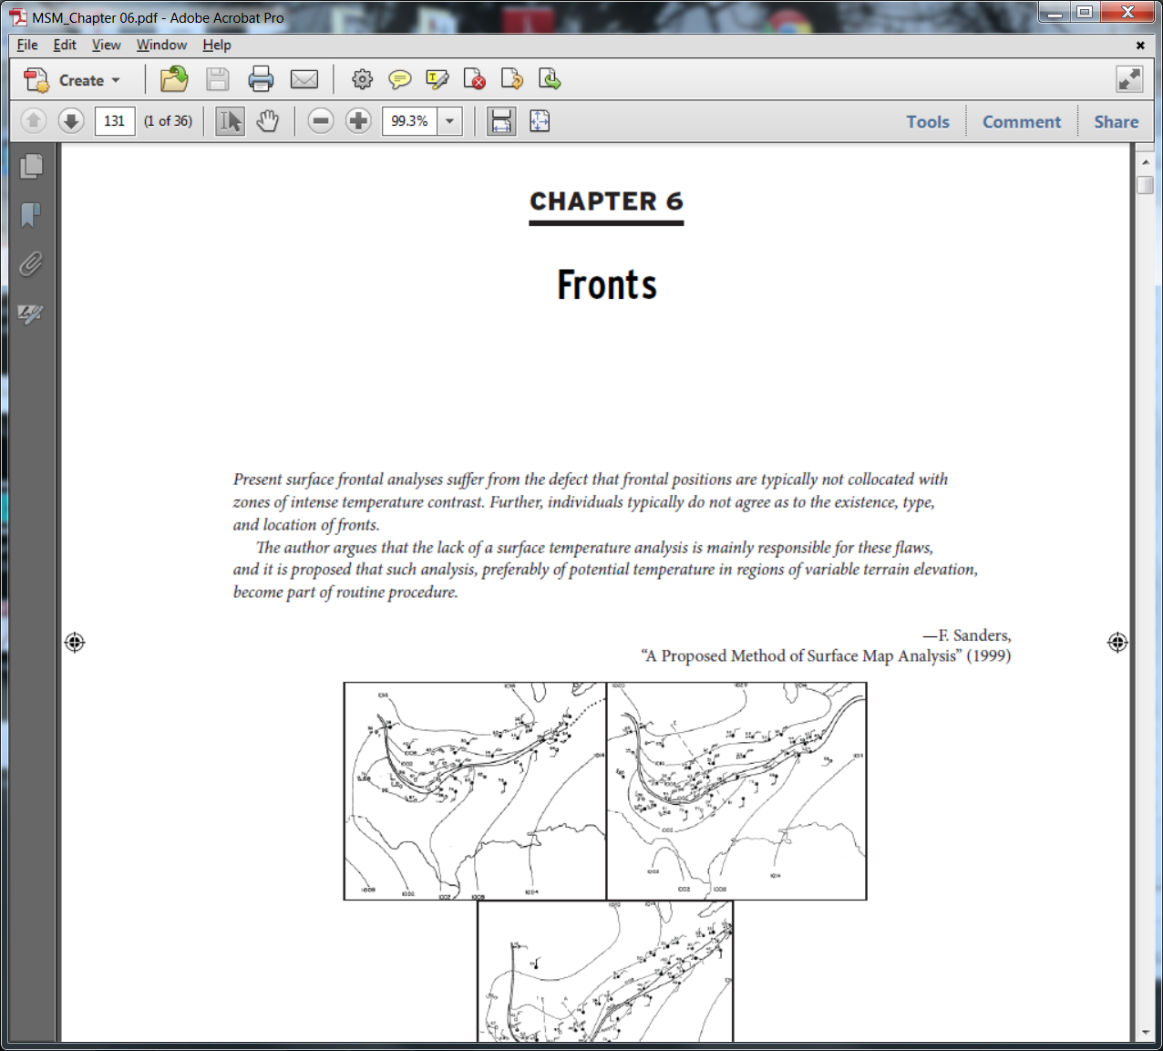
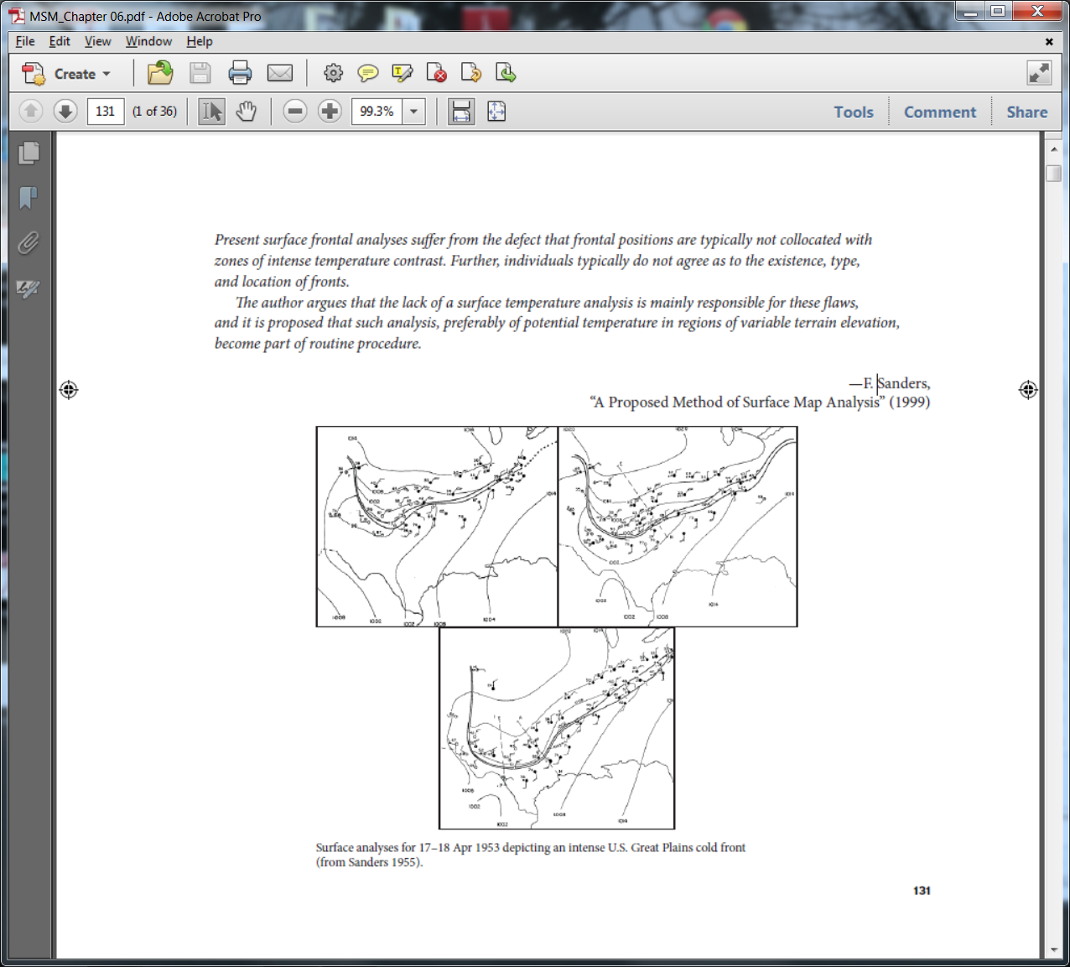
Lackmann (2011): Midlatitude Synoptic Meteorology

Slide 2
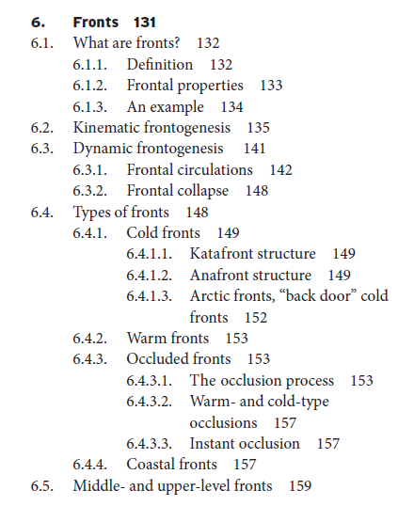
Chapter 6: Fronts

Slide 3
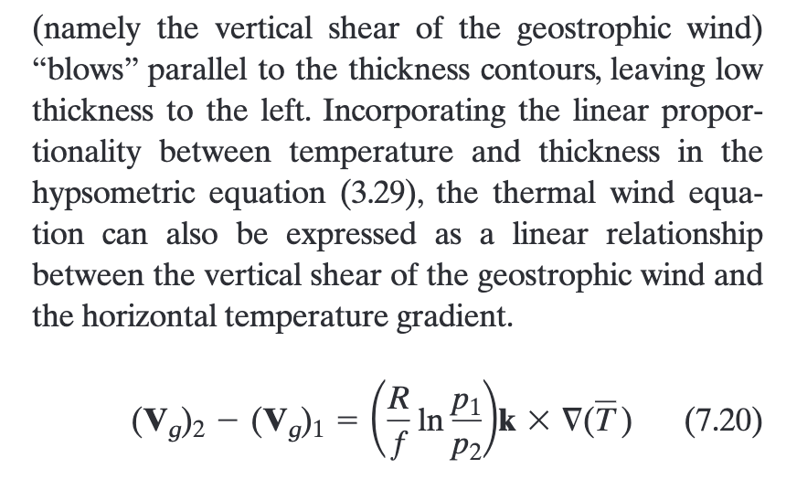
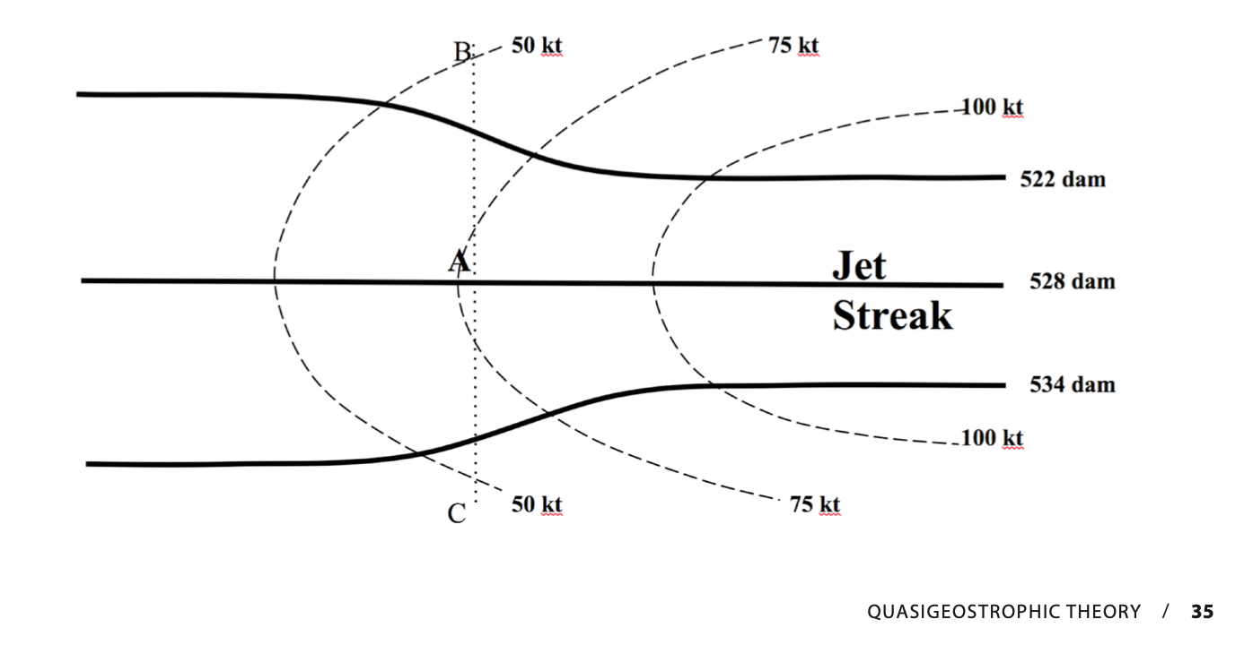
a balance condition”
Surface wind zero
All wind is thermal wind
(parallel to isotherms)
Thermal advection zero
Momentum advection alone is acting to break TW balance condition
What is the secondary circulation that would act to maintain TWB?

Slide 4
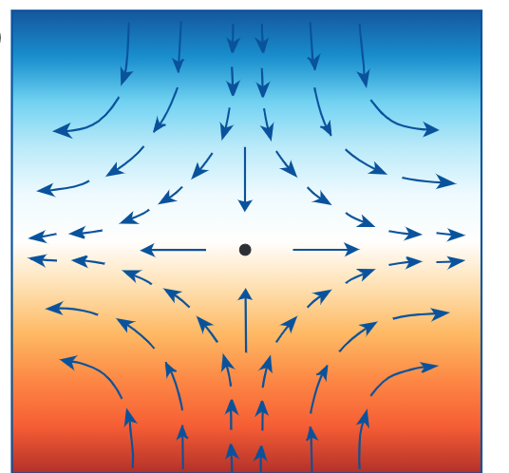
a balance condition”
Surface wind is deformation
Thermal wind is westerly
(parallel to isotherms) U>0
with no gradients in domain
→ Momentum advection zero
Thermal advection alone is acting to break TW balance condition
What is the secondary circulation that would act to maintain TWB?

Slide 5
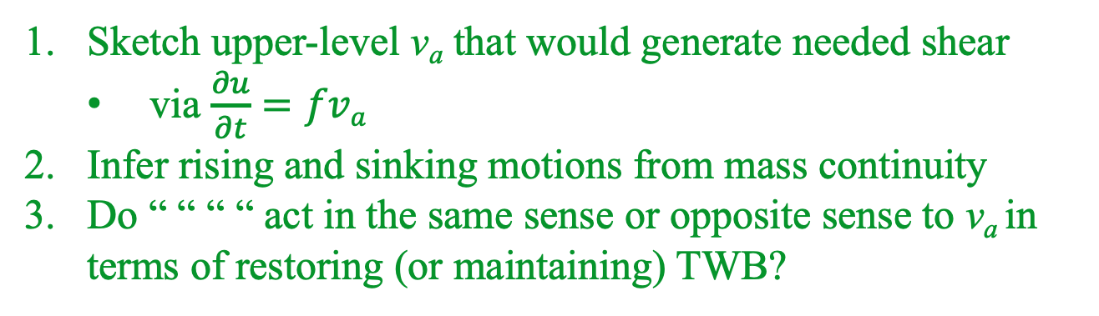
What is the secondary circulation that would act to maintain TWB?
Sketch upper-level v_{a} that would generate needed shear
via $\frac{∂u}{∂t}=fva$
Infer rising and sinking motions from mass continuity
Do “ “ “ “ act in the same sense or opposite sense to v_{a} in terms of restoring (or maintaining) TWB?

Slide 6
What is a front?
Surprisingly, not a clear consensus or definition!
Bluestein (p. 239): “hypergradient” ⎯ gradient that is an order-of-magnitude larger than typical synoptic-scale value
Fronts could be defined as hypergradients of temperature or potential temperature
Alternatively, can be thought of as air mass boundaries
Some suggest drawing fronts on weather maps is not necessary. They argue for “letting the isotherms speak for themselves”. (Sanders and Hoffman, August 2002 Wea. Forecasting).

Slide 7
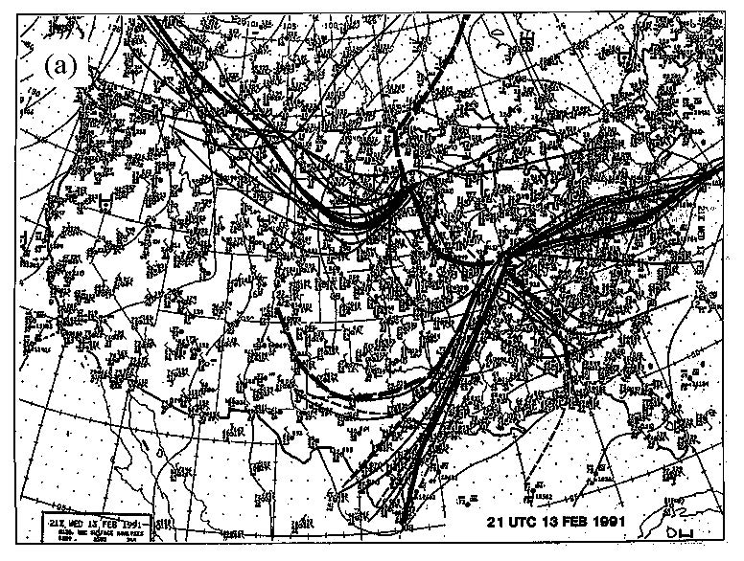
Expert Frontal Analyses (from NCEP workshop) - Bulletin of AMS, Uccellini
Notes:
2

Slide 8
Frontal characteristics
1000 mb
1004 mb
Fig 6.2b
T-3ΔT
T-2ΔT
T-ΔT
T
Isotherm packing typically begins on cold side of boundary
Often pronounced wind shift at front

Slide 9
Frontal characteristics
Fronts are both mesoscale and synoptic-scale features:
• Across-front length scale:__________
• Along-front length scale: __________
What is the link between fronts and jets aloft?
Why do we expect fronts to often be accompanied by clouds and precipitation?
~ 100 km
~ 1000 km
Recall thermal wind concept
Zones of strong temperature gradient often associated with disruption of thermal wind balance, QG forcing

Slide 10
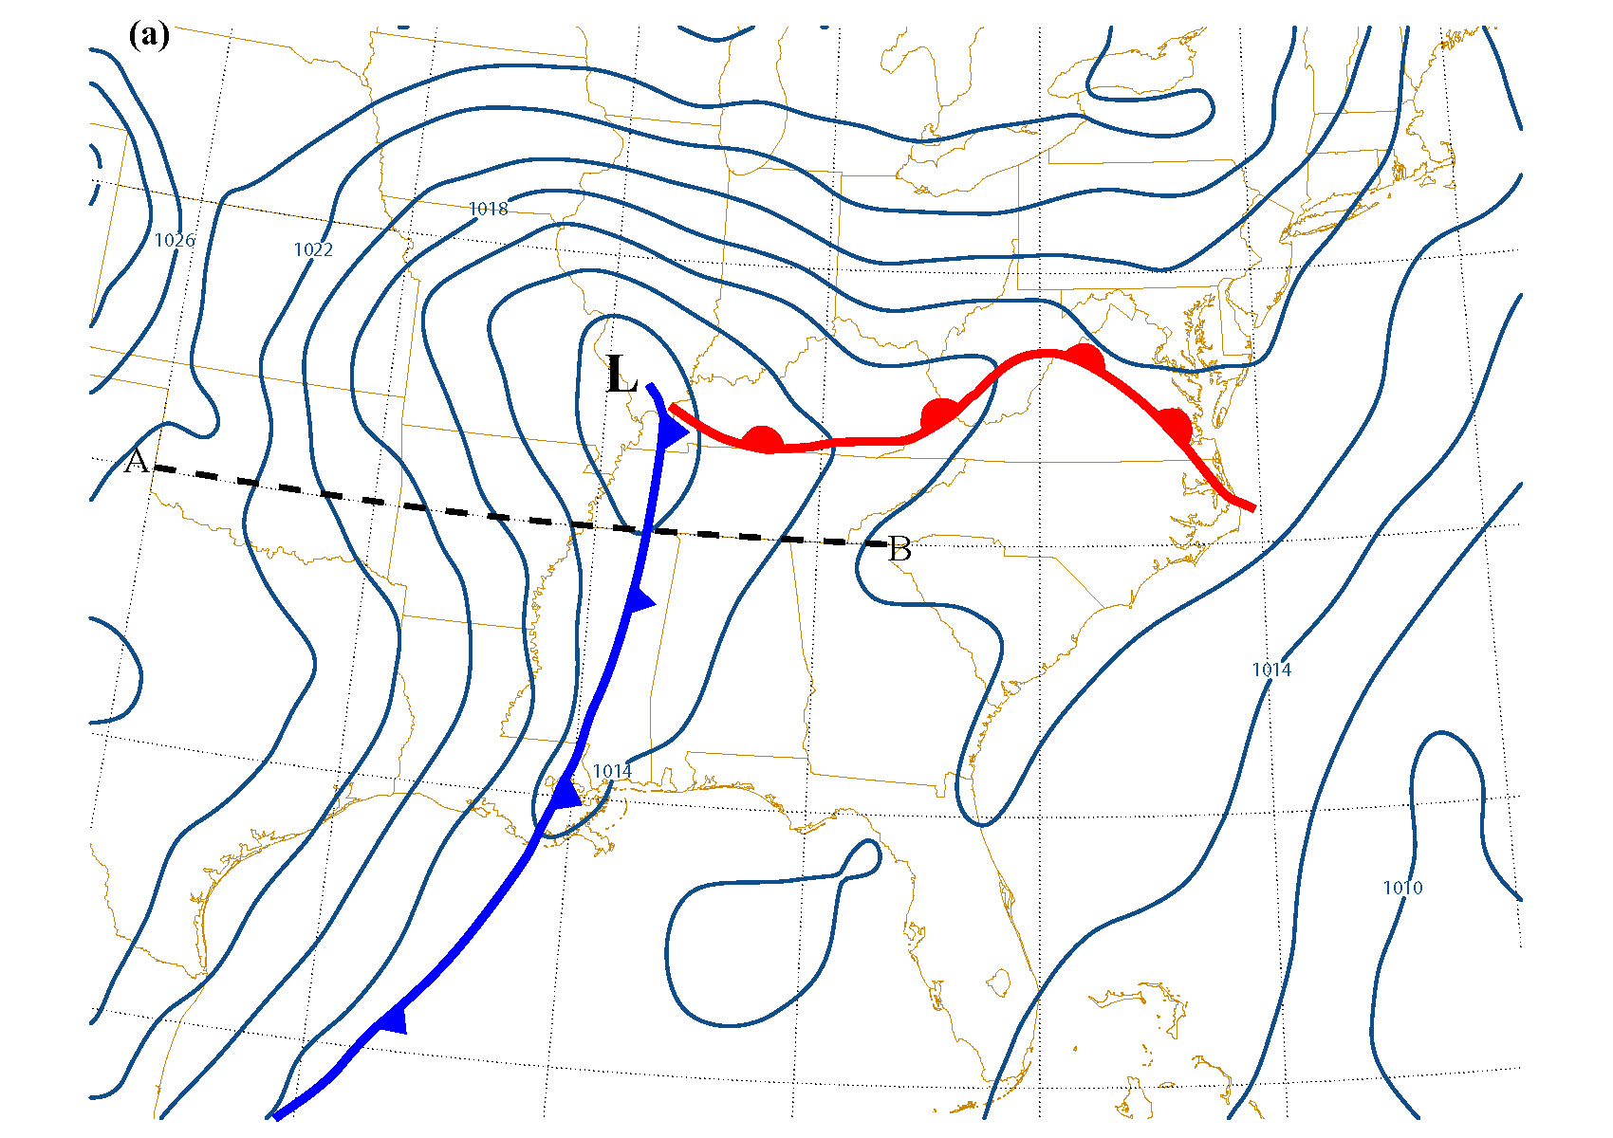
NAM analysis, 00 UTC 17 Nov 2009
SLP analysis

Slide 11
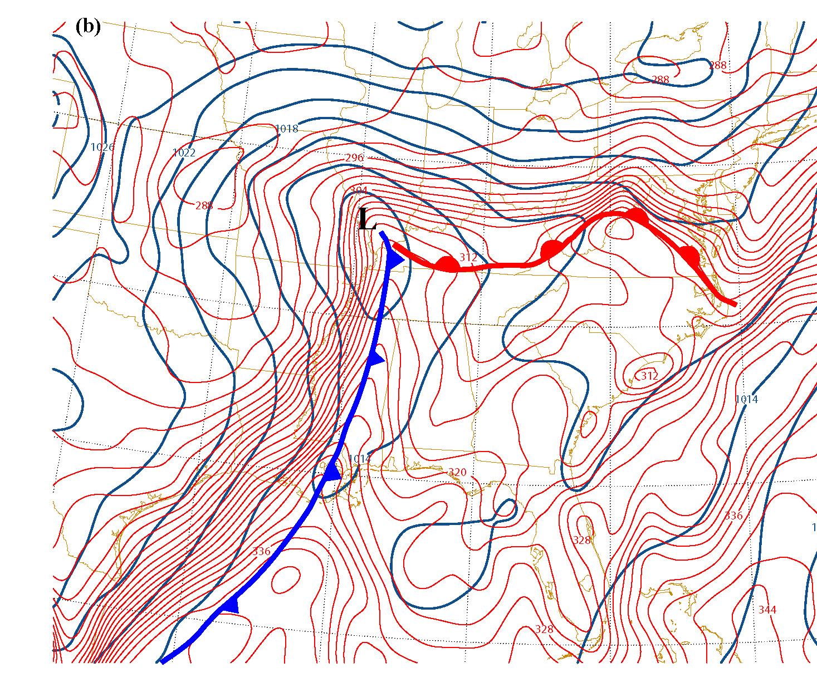
NAM analysis, 00 UTC 17 Nov 2009
Hypergradient of θ and θ_{e}
SLP analysis + equivalent potential temperature

Slide 12
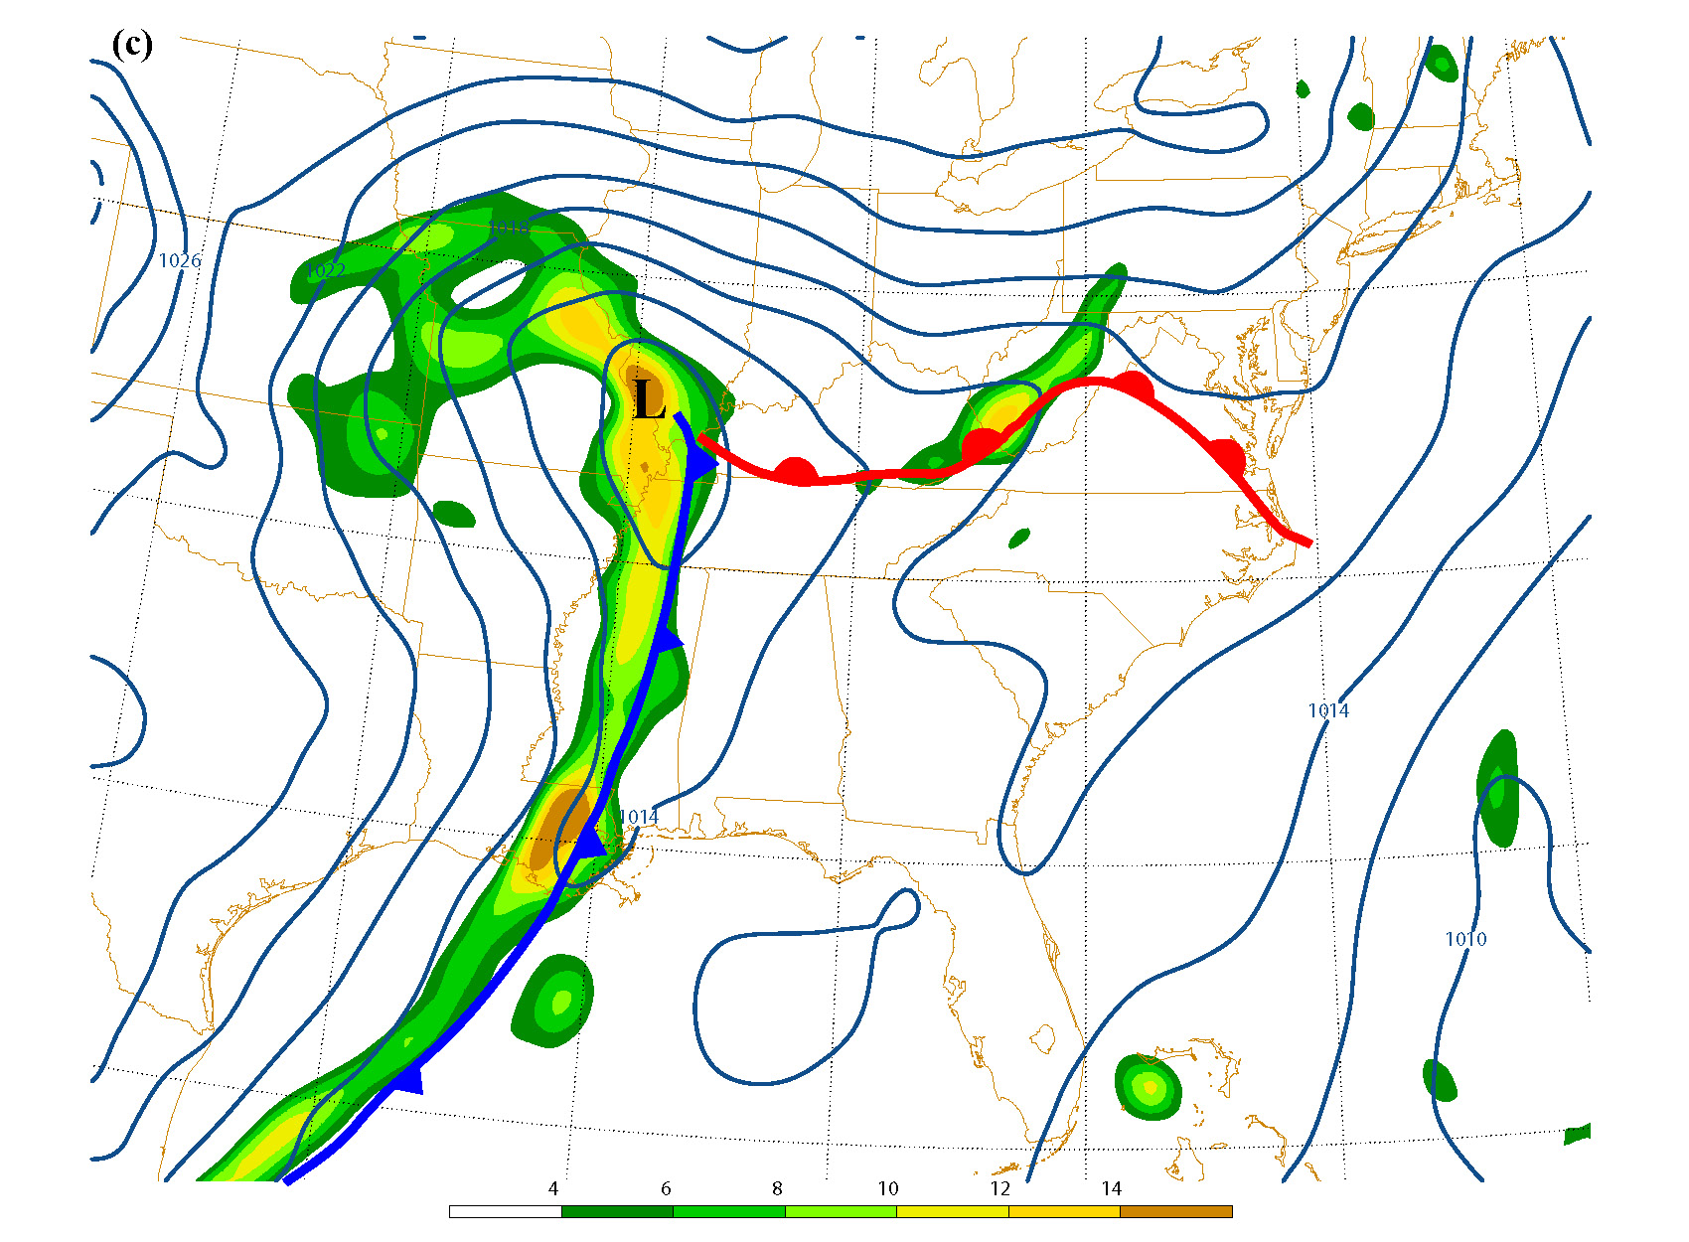
NAM analysis, 00 UTC 17 Nov 2009
A
B
Cyclonic relative vorticity
SLP analysis + vorticity (from 10 m wind, shaded, interval as in legend x10⁻⁵s⁻¹)

Slide 13
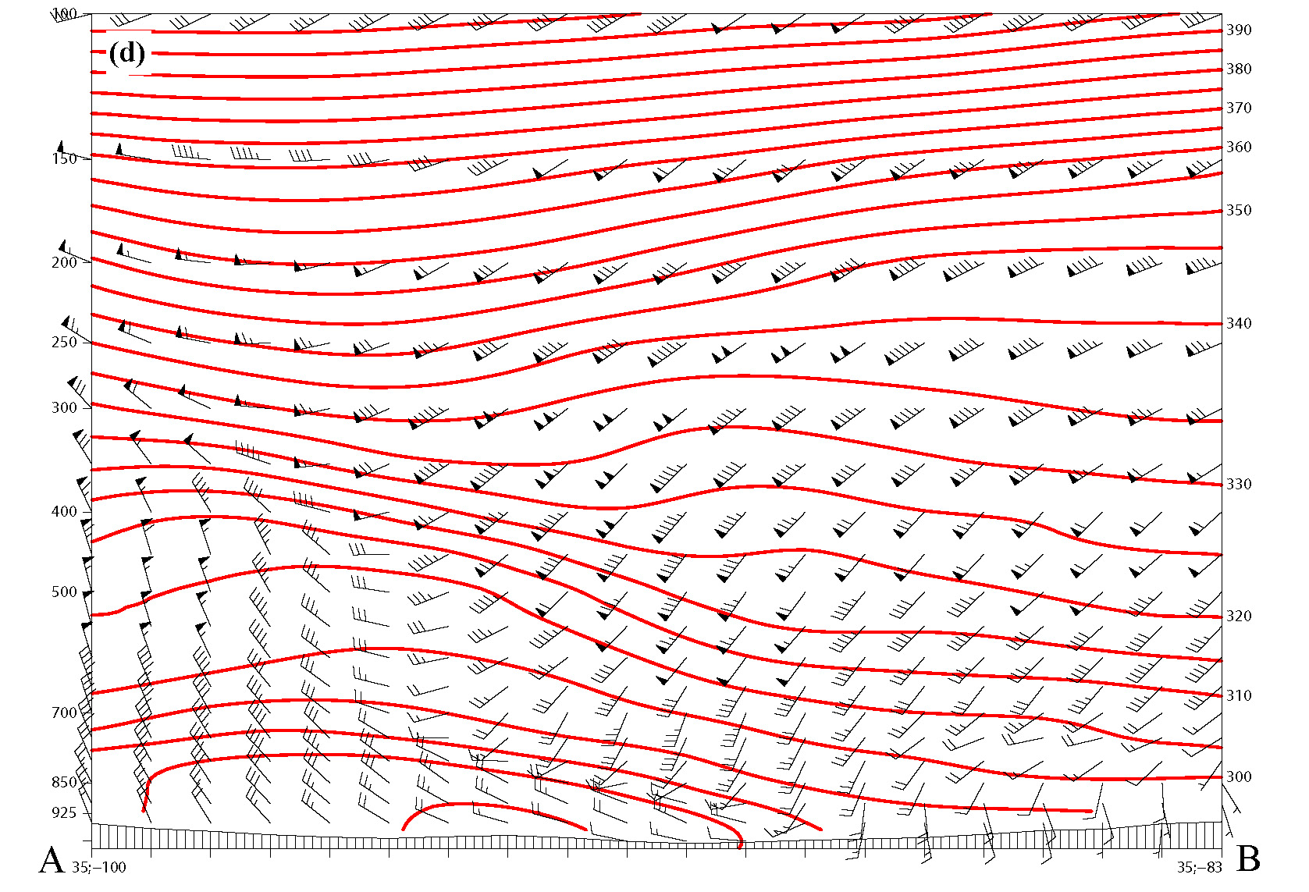
NAM θ analysis, 00 UTC 17 Nov 2009
Large static stability
Given just this cross section, could you identify the type of front? How?

Slide 14
Section Outline
6. Fronts
6.1. What is a Front?
6.2. Kinematic Frontogenesis
6.3. Dynamic Frontogenesis
6.4. Types of Frontal Systems
6.5. Middle- and Upper-Level Fronts
Notes:
2

Slide 15
Mechanisms of Frontogenesis
Frontogenesis is simple:
Processes that make the warm air warmer and/or the cold air colder are frontogenetical
Processes that cool the warm air or warm the cool air are frontolytic
Notes:
2

Slide 16
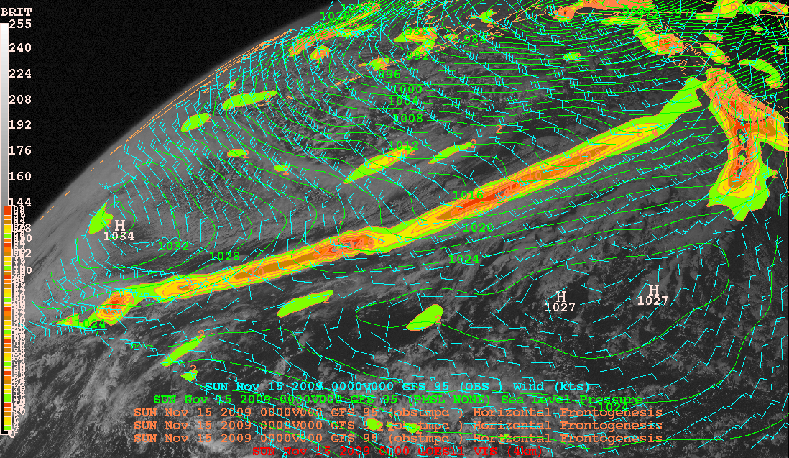
Frontal coordinate: x’ axis along isotherms
y’ direction
x’ direction

Slide 17
a.) Shearing – front-parallel wind
5°C
Is shearing strengthening or weakening the cold front?
10°C
COLD
5°C
L
15°C
10°C
x’
15°C
y’
20°C
WARM
30°C
25°C

Slide 18
a.) Shearing – front-parallel wind
5°C
Is shearing strengthening or weakening the cold front?
10°C
COLD
L
15°C
5°C
20°C
10°C
x’
y’
25°C
15°C
WARM
30°C

Slide 19
a.) Shearing – front-parallel wind
0°C
10°C
15°C
5°C
y’
x’
0°C
5°C
L
Is shearing strengthening or weakening the warm front?
10°C
15°C
20°C
25°C

Slide 20
a.) Shearing – front-parallel wind
0°C
5°C
15°C
10°C
y’
x’
0°C
5°C
L
Easy rule: Differential advection- if warm air gets warmer and cold air colder: FG
Otherwise, FL
10°C
15°C
20°C
25°C

Slide 21
b.) Confluence – front normal wind
0°C
5°C
10°C
15°C
y’
x’
20°C

Slide 22
b.) Confluence – front normal wind
-5°C
0°C
5°C
10°C
15°C
y’
x’
20°C

Slide 23
Deformation pattern: FG or FL depending on relative orientation of axis of dilatation, isentropes
(a)
Axis of dilatation

Slide 24
Deformation pattern: FG or FL depending on relative orientation of axis of dilatation, isentropes
(b)
Axis of dilatation

Slide 25
Deformation pattern: FG or FL depending on relative orientation of axis of dilatation, isentropes
(c)
Axis of dilatation

Slide 26
Deformation pattern: FG or FL depending on relative orientation of axis of dilatation, isentropes
(d)
Axis of dilatation

Slide 27
d.) Diabatic term
Initial time
sun
Cloud deck
up
COLD
WARM
Surface
+y’
After Carlson 1998

Slide 28
d.) Diabatic term
Later
sun
Cloud deck
p
up
COLD
WARMER
Surface
+y’
After Carlson 1998

Slide 29
Section Outline
6. Fronts
6.1. What is a Front?
6.2. Kinematic Frontogenesis
6.3. Dynamic Frontogenesis (Ch 6, pages 141-148)
- QG Frontogenesis
- Frontal Circulations – Sawyer-Eliassen equation
- Frontal Collapse
6.4. Types of Frontal Systems
6.5. Middle- and Upper-Level Fronts
Notes:
2

Slide 30
Q-Vectors
Hoskins and Pedder (1975) present alternate form of omega equation which eliminates cancellation problem between d/dz(vert. adv.) + warm advection terms:
Where **(fix multiplier)**

Slide 31
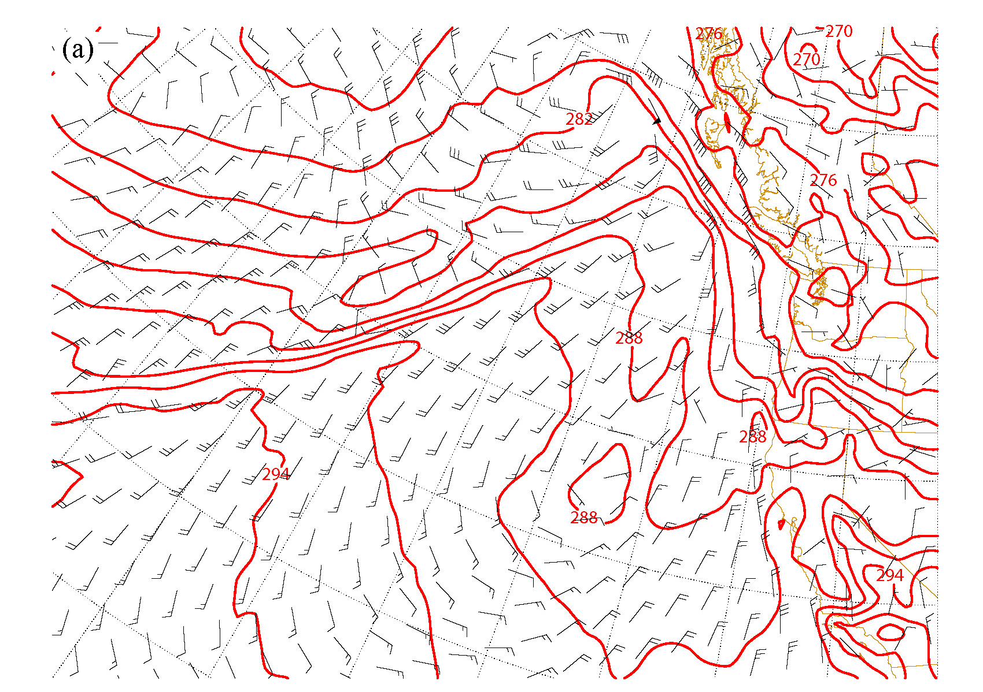
GFS analysis, 12 UTC 14 Nov 2008 10-m wind, 1000-mb potential temperature
Is primary flow FG or FL? (confluence + shear)
Geostrophic primary flow is strengthening thermal gradient
Which way do we expect Q_{n} to point?

Slide 32
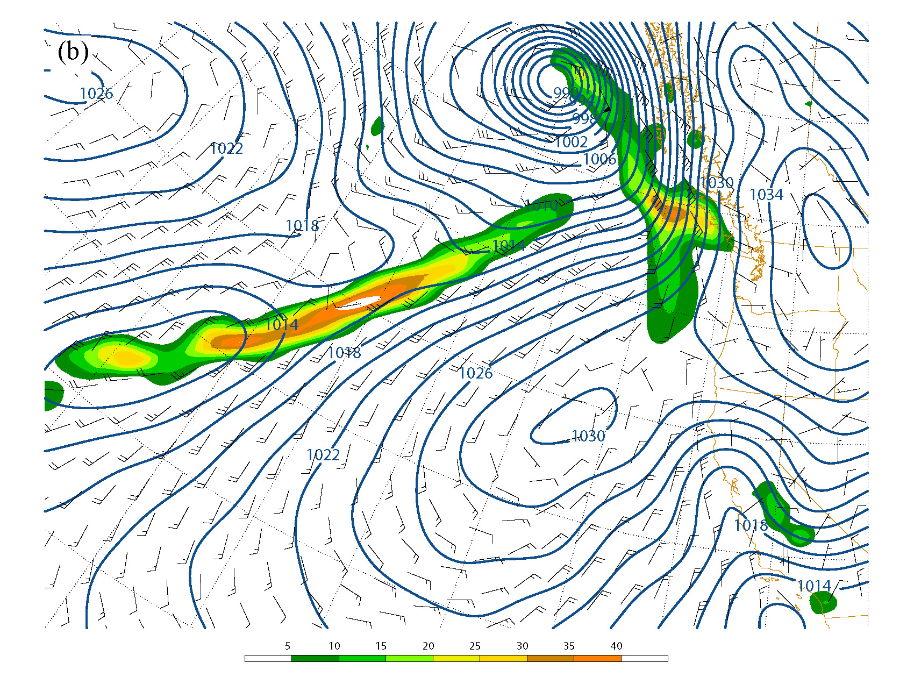
GFS analysis, 12 UTC 14 Nov 2008 10-m wind, SLP 1000-mb Frontogenesis
Geostrophic primary flow is strengthening thermal gradient
Which way do we expect Q_{n} to point?

Slide 33

GFS analysis, 12 UTC 14 Nov 2008 SLP, 1000-mb Frontogenesis, Q
Expect Q_{n} to point towards warm side of front
Secondary circulation response should be thermally direct: warm air rising, cold air sinking: oppose effect of primary circ.
Geostrophic primary flow is strengthening thermal gradient
Which way do we expect Q_{n} to point?

Slide 34
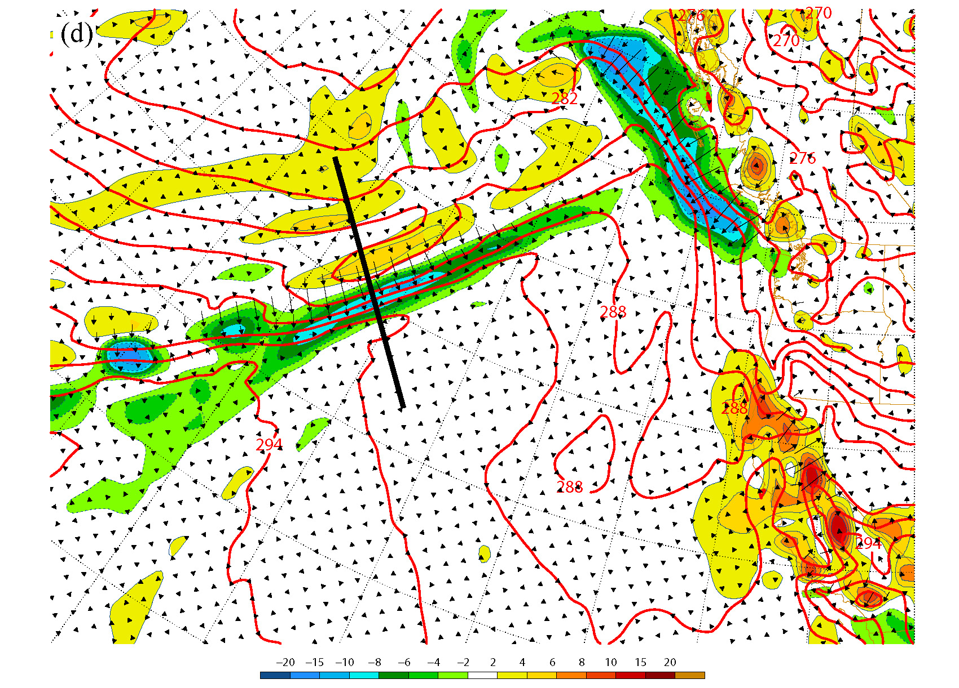
GFS analysis, 12 UTC 14 Nov 2008 SLP, 1000-mb Frontogenesis, 850-mb Q, omega

Slide 35
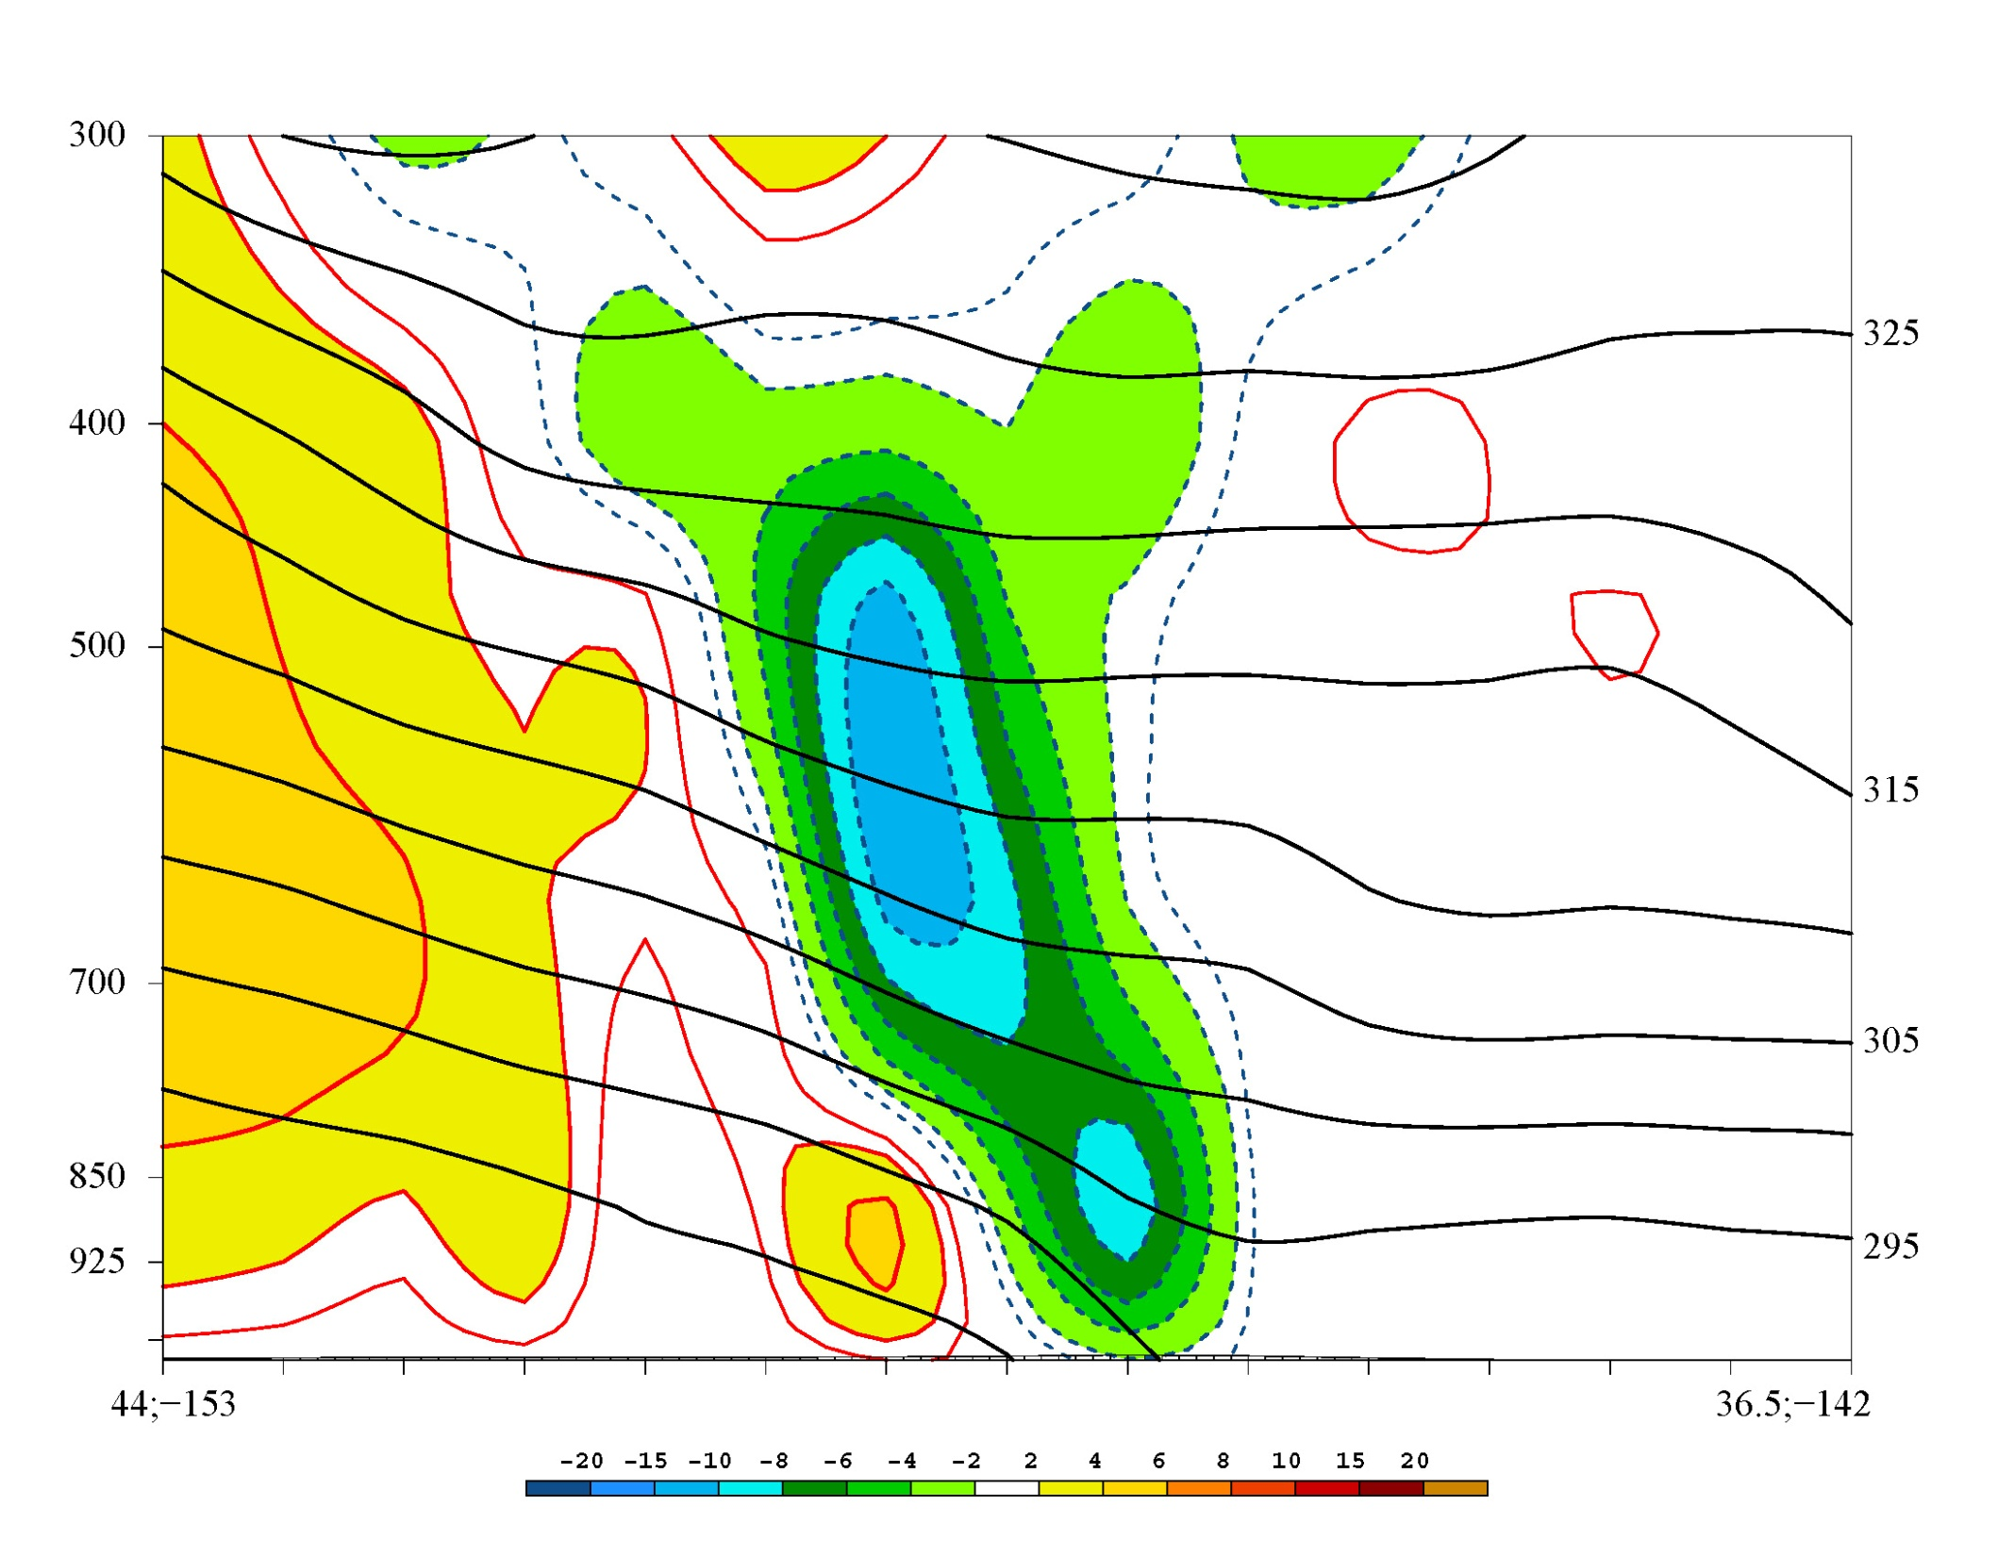
Secondary circulation: warm air rising, cold air sinking, opposes primary circulation's frontogenesis
COLD

Slide 36
Summary of QG Frontogenesis
Geostrophic frontogenesis / frontolysis lead to disruption of thermal wind balance
Ageostrophic frontal circulation acts to restore thermal wind balance -→ can result in clouds, precipitation
Frontogenesis leads to ascent on warm side of front
"Semi-geostrophic" extension to QG theory: Allow cross-frontal secondary ciyculation to advect isotherms.

Slide 37
a QG theory weakness:
z
z
θ
θ-Δθ
θ-2Δθ
θ
θ-Δθ
Ageostrophic secondary circulation – doesn’t advect isentropes in QG approx.
θ-2Δθ
Ageostrophic secondary circulation – does advect isentropes
y
Primary flow (FG)
y
Primary flow (FG)
Later
Initial time
If QG equations used, it takes too much time for front to reach observed strength

Slide 38
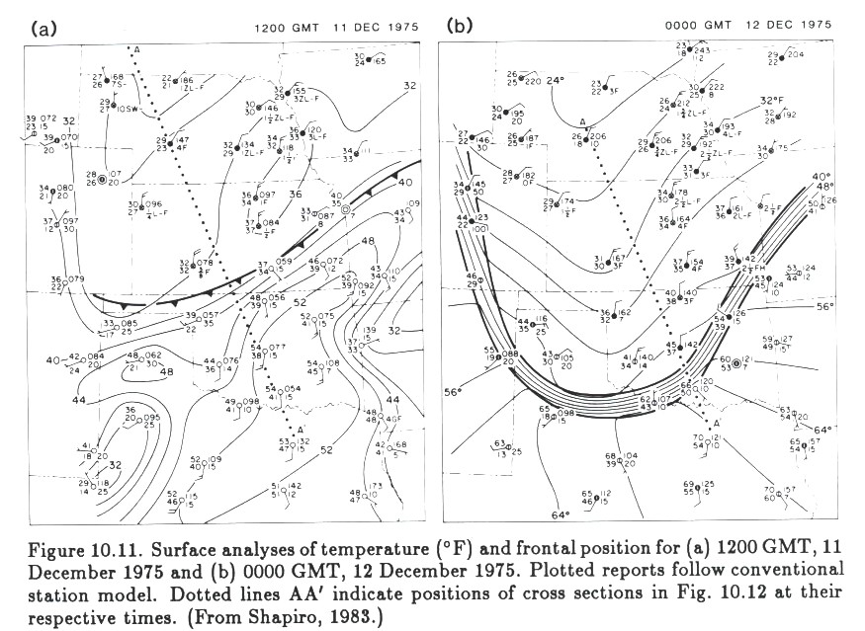
Frontal Collapse
Observations: Some surface fronts accompanied by mesoscale discontinuity
How does this come about?
Fronts that have taken on this structure are said to have “collapsed”
Shapiro (1983)

Slide 39
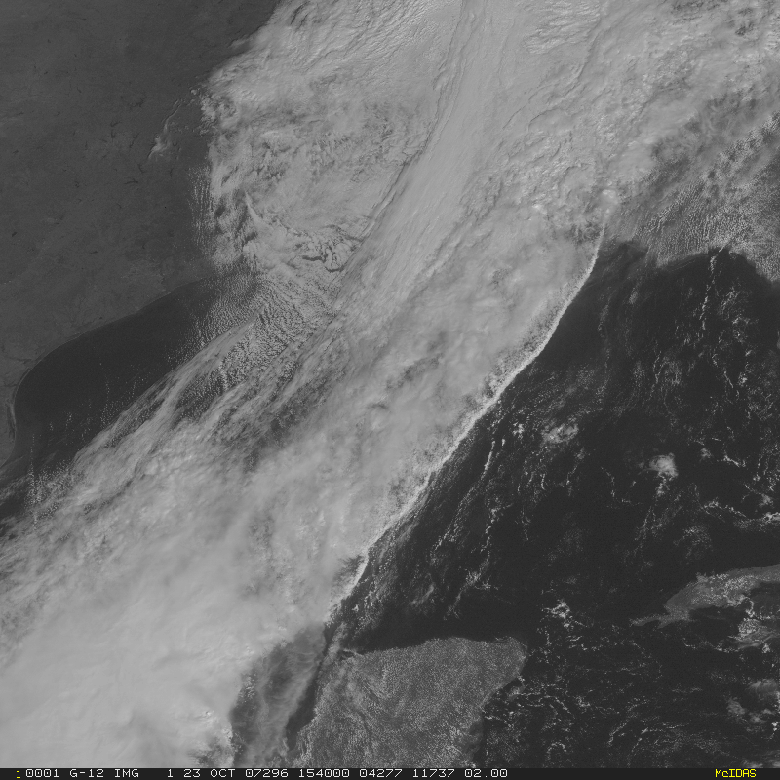
Frontal Collapse
Near-surface fronts can be associated with a narrow cold-frontal rainband (NCFR), “rope cloud” in satellite/radar imagery
How does discontinuity form? Ageostrophic contribution to FG strongest at surface, no vertical motion can compensate it there

Slide 40
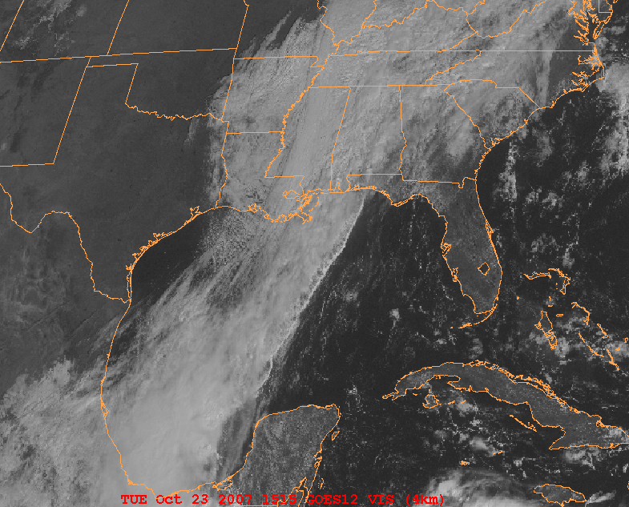
Frontal Collapse and Narrow Cold Frontal Rainbands (NCFR)

Slide 41
Frontal Collapse and Narrow Cold Frontal Rainbands (NCFR)
http://cimss.ssec.wisc.edu/goes/blog/archives/555

Slide 42
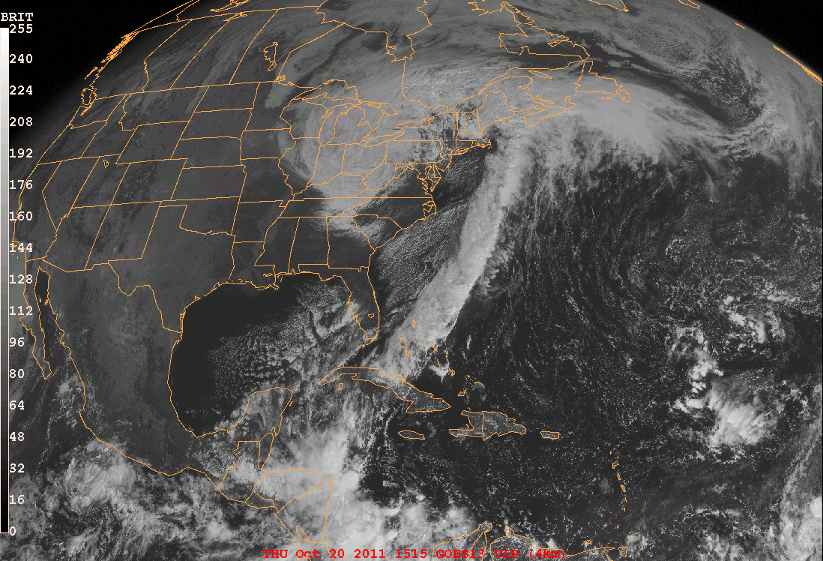
Frontal Collapse and Narrow Cold Frontal Rainbands (NCFR)
Frontal Collapse and Narrow Cold Frontal Rainbands (NCFR)
15:15 UTC 20 Oct 2011

Slide 43
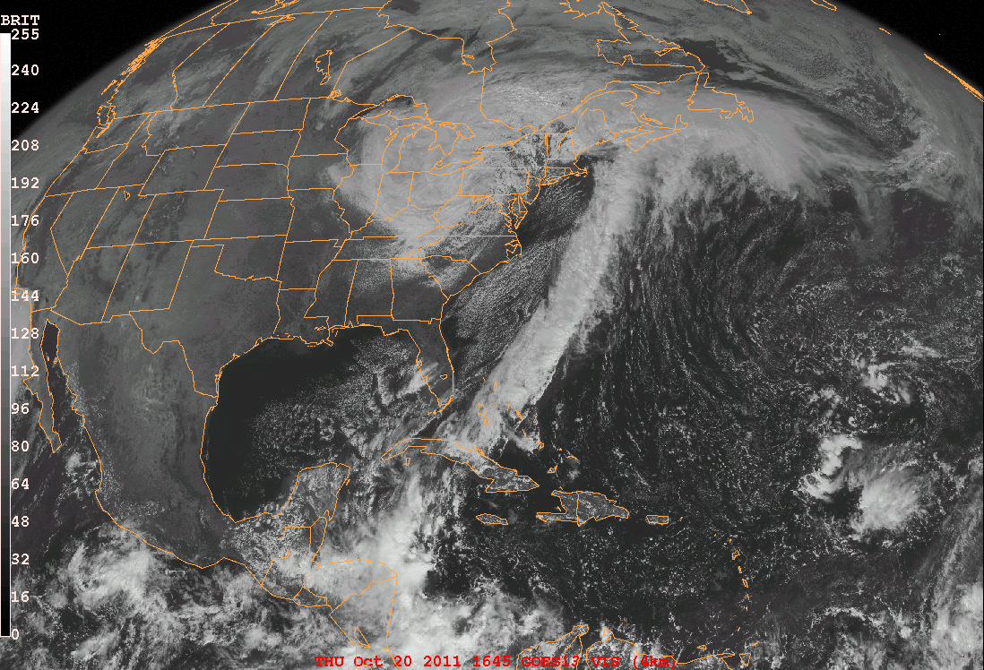
Frontal Collapse and Narrow Cold Frontal Rainbands (NCFR)
1515 UTC Thursday 20 October 2011
Frontal Collapse and Narrow Cold Frontal Rainbands (NCFR)
18:15 UTC 20 Oct 2011

Slide 44
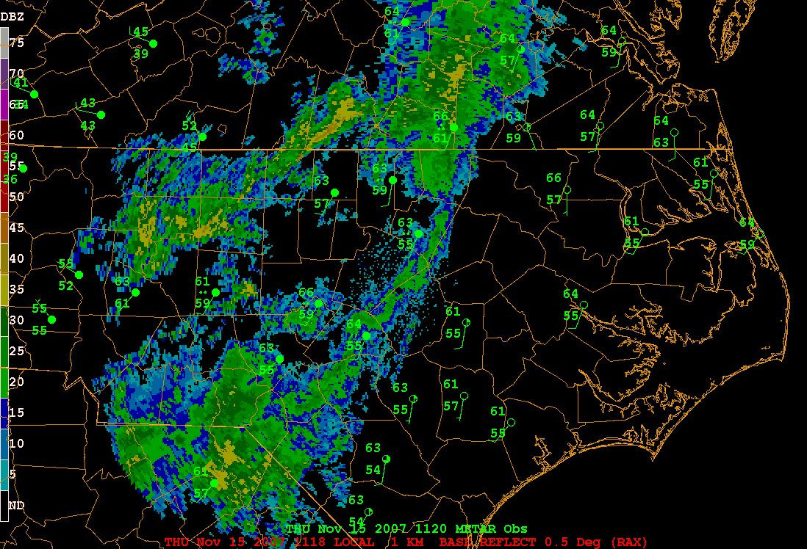
Frontal Collapse and NCFR: 15 Nov 2007

Slide 45
Recap
Why is it important to include non-QG effects in frontal dynamics?
Because flow is not QG in cross-front direction
Ageostrophic advection by frontal circulation important
Why are fronts typically most intense at the surface?
Compensating warming/cooling due to vertical motion, which weakens front aloft, cannot work at surface

Slide 46
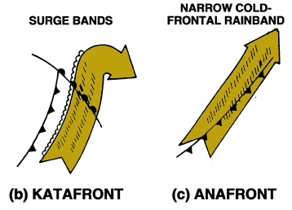
Types of cold-frontal rainbands
Based on airflow relative to front, and location of precipitation, can classify most cold fronts as “katafront” or “anafront” structures
a.) Katafront
b.) Anafront

Slide 47
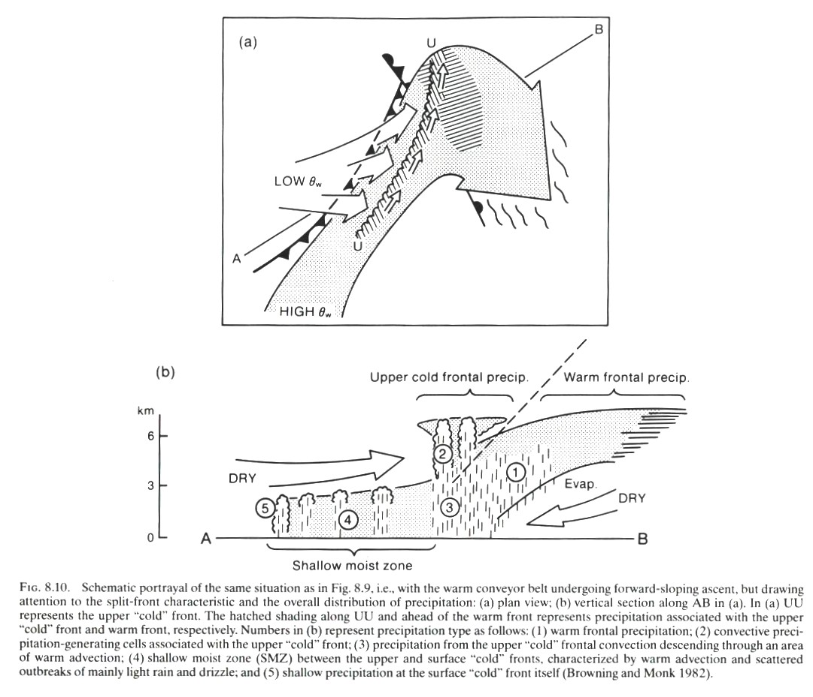
Cold Fronts: a.) Katafront structure
Cold front aloft (CFA)
Forward-sloping ascent, precipitation concentrated at or ahead of surface cold front

Slide 48
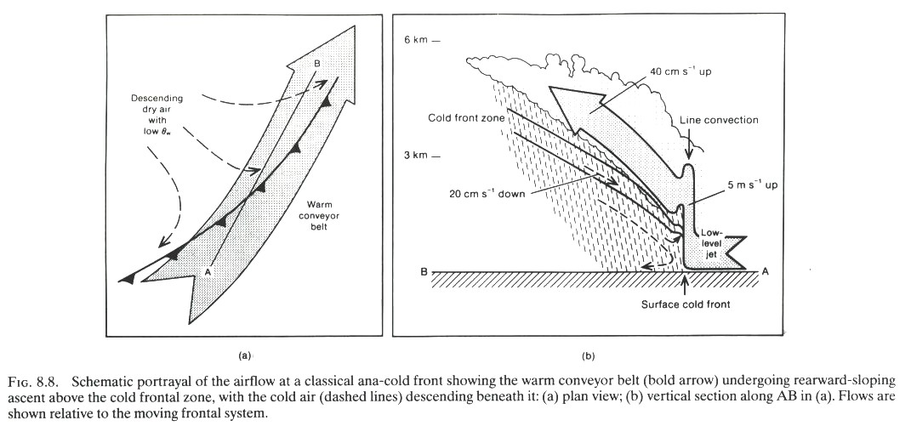
Cold Fronts: b.) Anafront structure
Rearward-sloping ascent with warm conveyor belt overrunning cold air, heaviest precipitation at or behind surface front

Slide 49
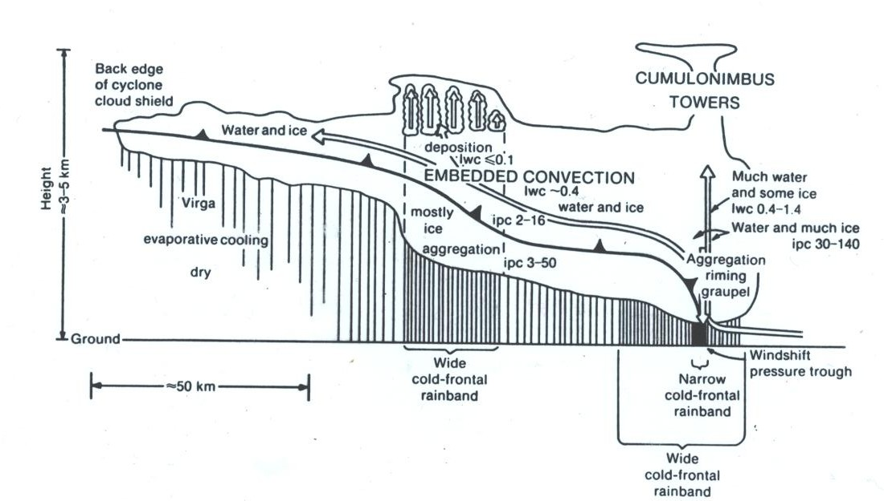
Cold Fronts: 2.) Anafront structure
Idealized cross section of anafront clouds and precipitation. Vertical lines represent precipitation, arrows represent airflow relative to front. IPC stands for ice-particle concentrations in # per liter, liquid water content (lwc) is given in g/m3. Figure from Matejka et al. (1980).

Slide 50
Katafront
-Cool, dry air aloft can push ahead of surface cold front (“cold front aloft”, or “CFA”)
-Limited depth of moisture near surface cold front reduces deep convection there
-Dry air above moist in katafront can be convectively unstable; if lifting present, convection can develop in this region
-If warm conveyor belt lacks normal component to cold front, precipitation generally won’t develop behind front

Slide 51
Anafront
-If front-relative flow in warm conveyor belt region has component normal to cold front, a zone of rearward-sloping ascent with lift over cold air leads to postfrontal precipitation
-May lead to wintry precipitation behind cold front, due to presence of cooler surface temperatures behind the front

Slide 52
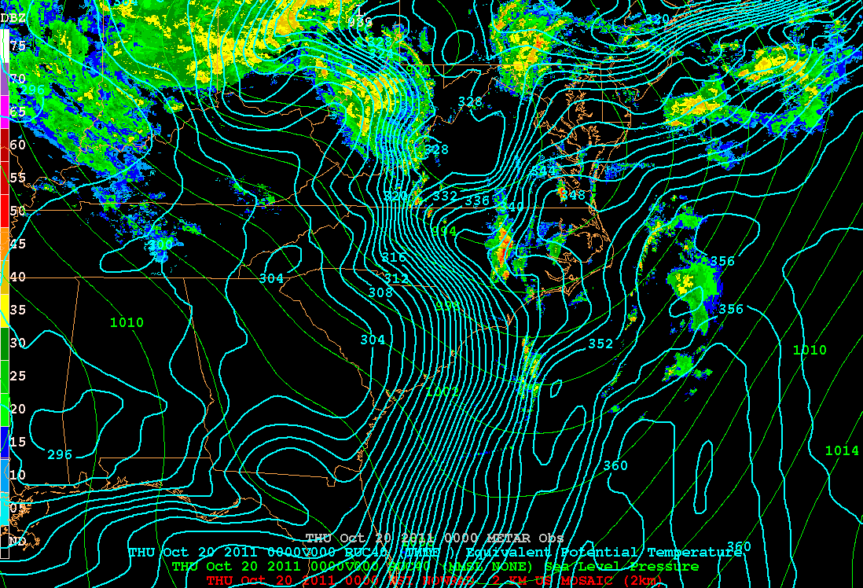
00 UTC 21 Oct 2011 – Katafront structure
[RUC SLP (green), θ_{e} (blue), radar mosaic]
Notes:
2

Slide 53
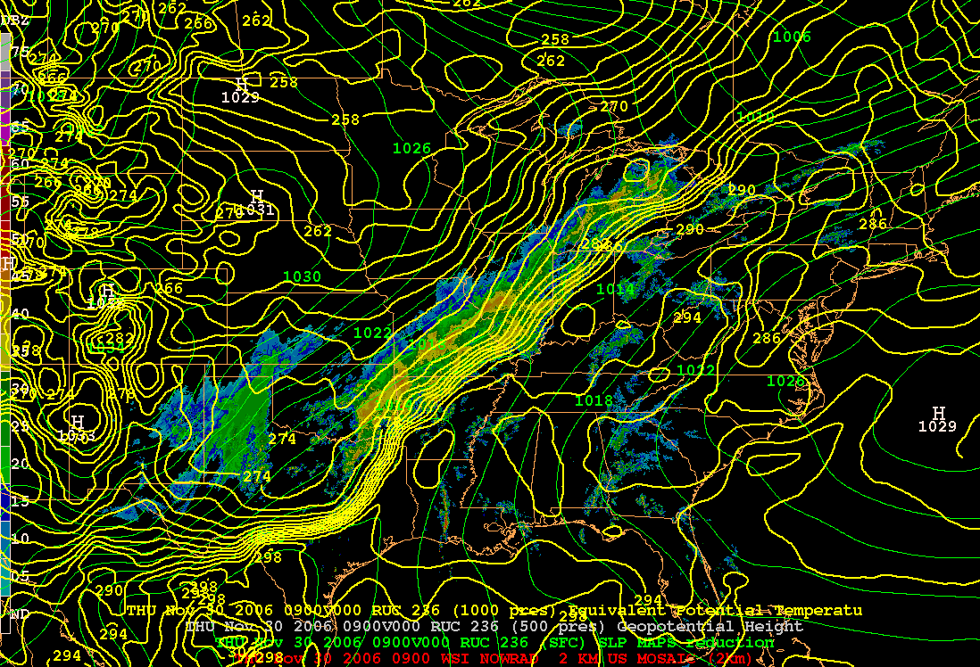
09 UTC 30 Nov 2006 – Anafront structure [RUC SLP (green), θ_{e} (yellow), radar mosaic]

Slide 54
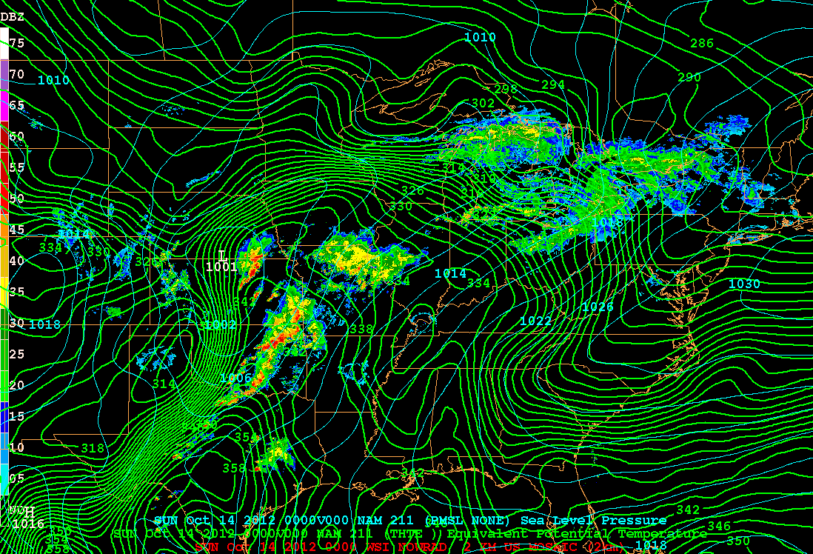
00 UTC 14 Oct 2012 – Katafront structure (cold front)
[NAM 1000-mb theta-e (green), SLP, (blue) radar mosaic]

Slide 55
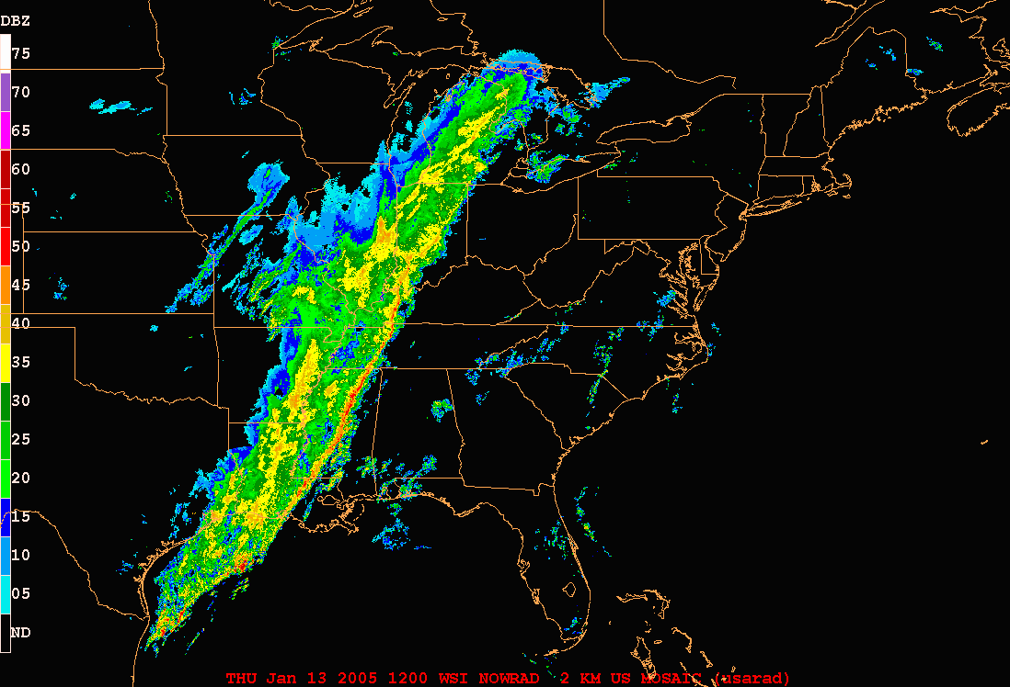
12 UTC 13 Jan – 00 UTC 15 Jan 2005 – Anafront case Radar, 3h intervals, 36h loop

Slide 56
Cold Fronts: Arctic Fronts
Often very shallow, dry, intense; movement like density current

Slide 57
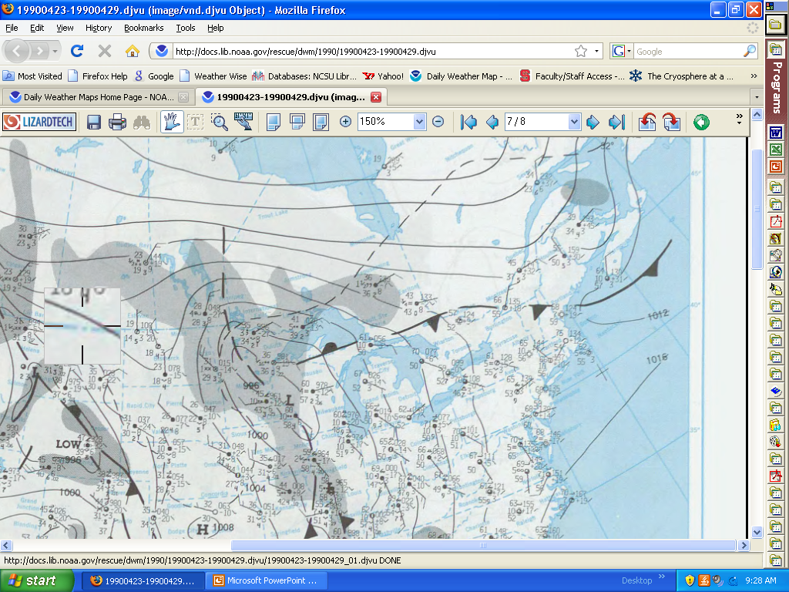
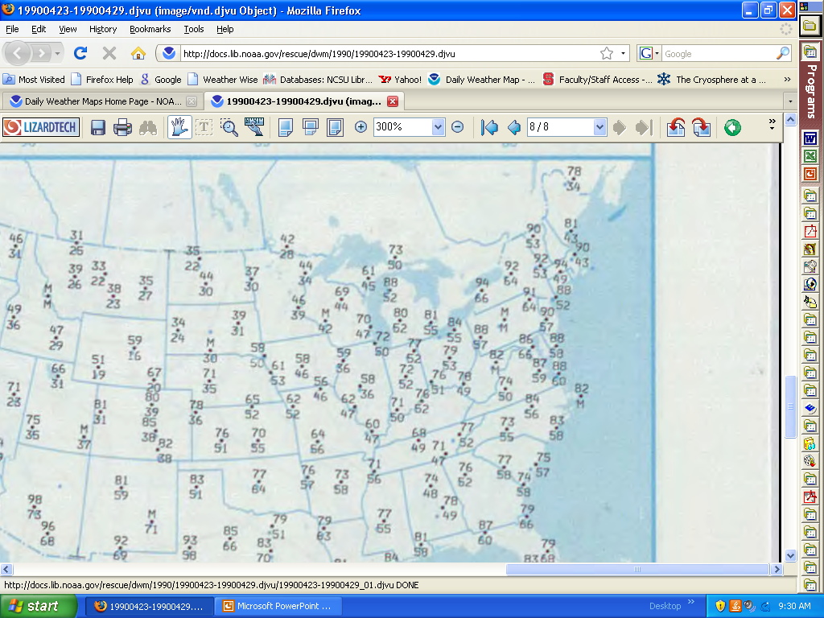
Cold Fronts: Back-Door Cold Front
New England back-door cold front, 29 Apr 1990

Slide 58
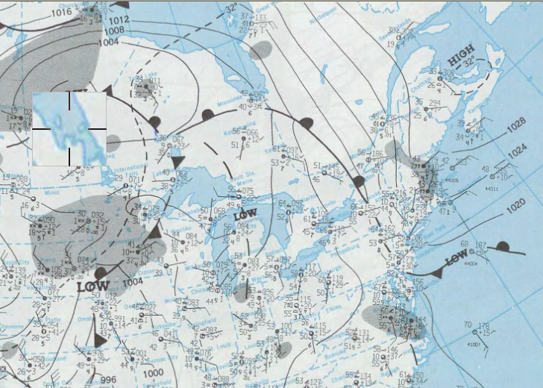
New England back-door cold front, 29 Apr 1990
Cold sea-surface temperatures

Slide 59
Warm Fronts
By definition, warm air advancing
Because warm air less dense, mixing contributes to frontal advance
Warm air advancing, sometimes discontinuously, veering wind with height
Shallow nature means less pronounced pressure trough
May not be strongly evident in some cyclones
Trough may precede surface front to mark location of warm front aloft
With anticyclone to N or NE, front will be most pronounced
“Easterlies north of warm front” - good analysis rule for locating warm front

Slide 60
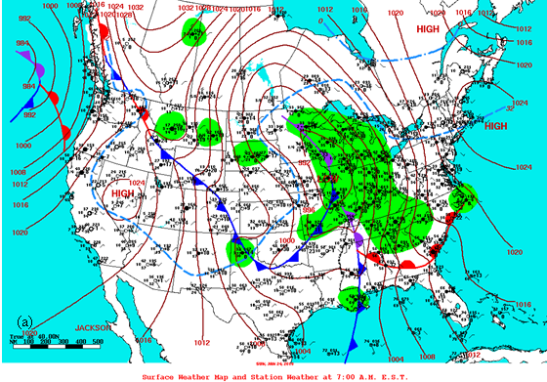
24 Jan 2010 Warm Front Example

Slide 61
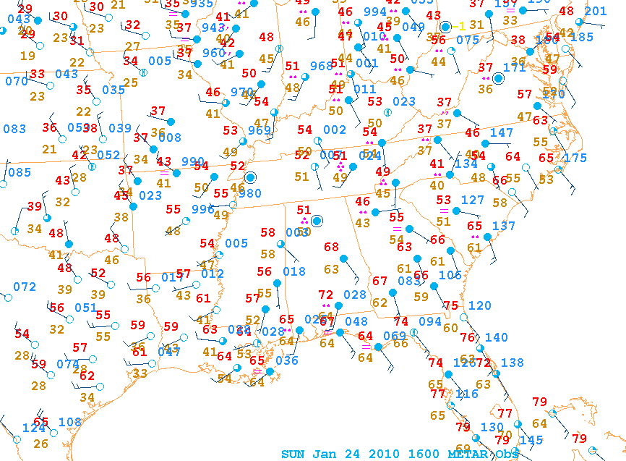

Slide 62
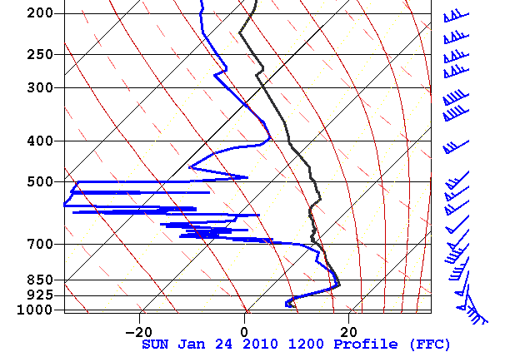
Layer of strongest veering?
Temperatures in this layer?
Heavy or light/no precipitation?

Slide 63
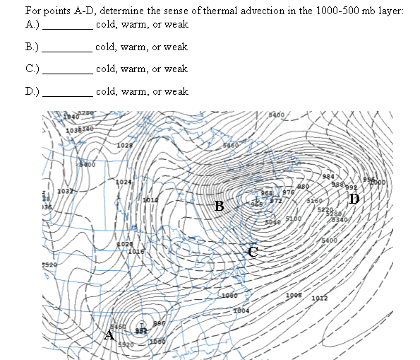
Warm Fronts: “Back door” warm front
Veering!

Slide 64
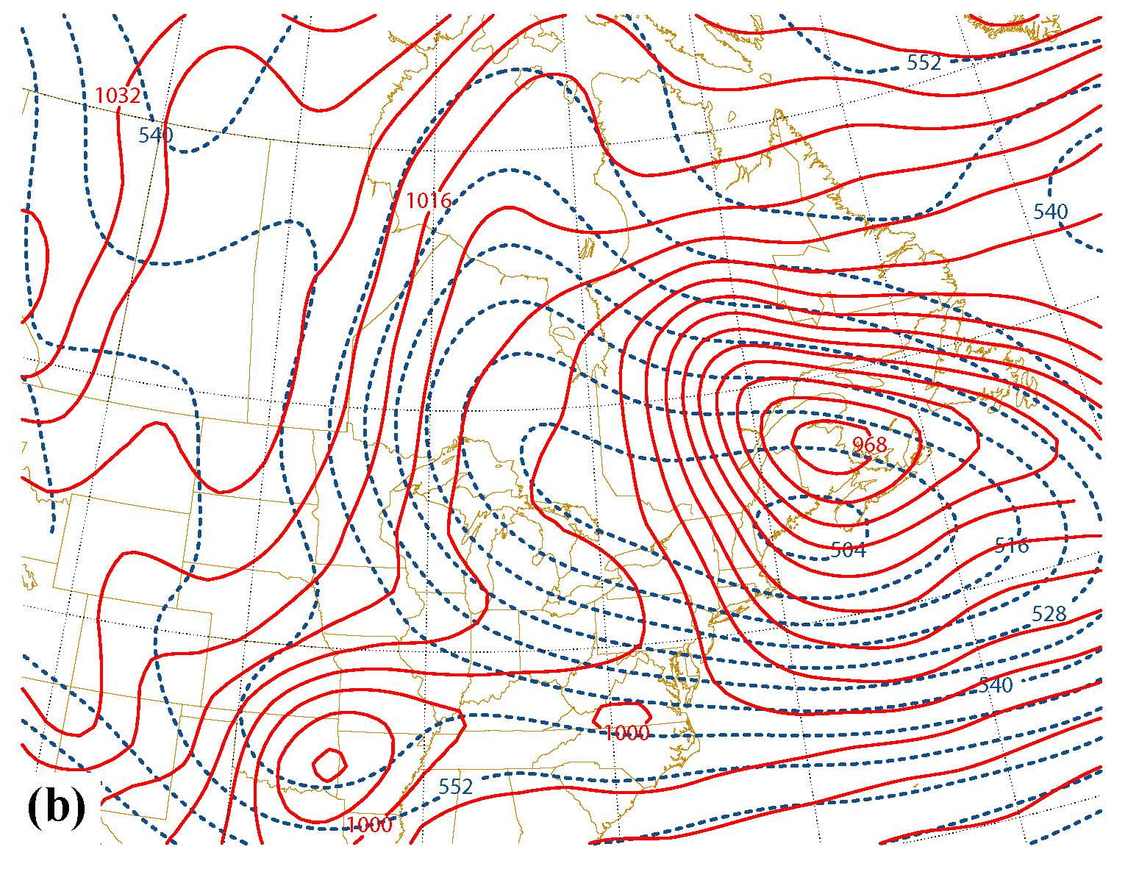
Warm Fronts: “Back door” warm front
Veering!

Slide 65
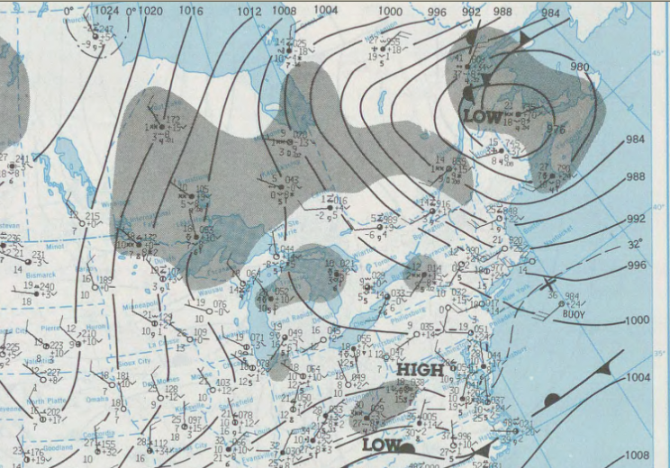
Warm Fronts: “Back door” warm front
(Relatively) warm maritime polar wraps around north side of cyclone:

Slide 66
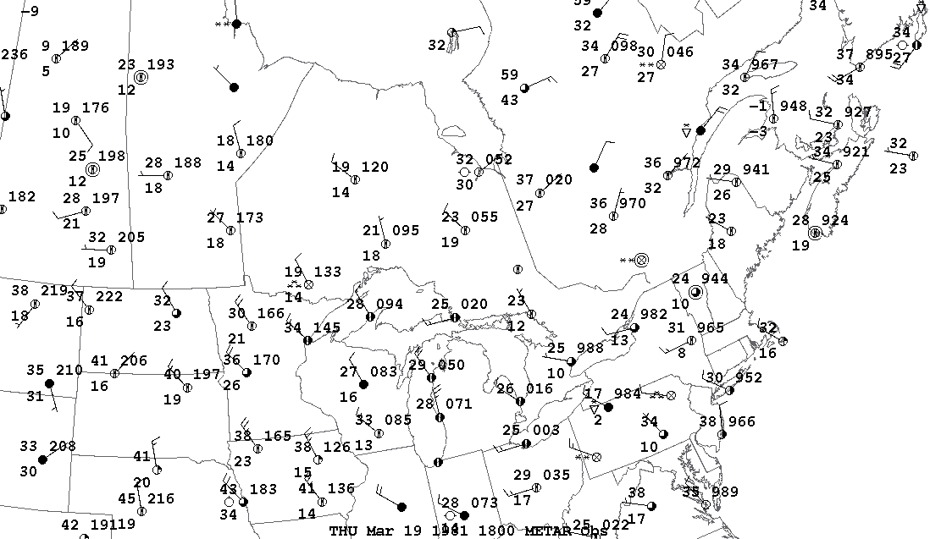
Warm Fronts: “Back door” warm front
Warm maritime polar wraps around north side of cyclone, warm advection to the NW of cyclone center:

Slide 67
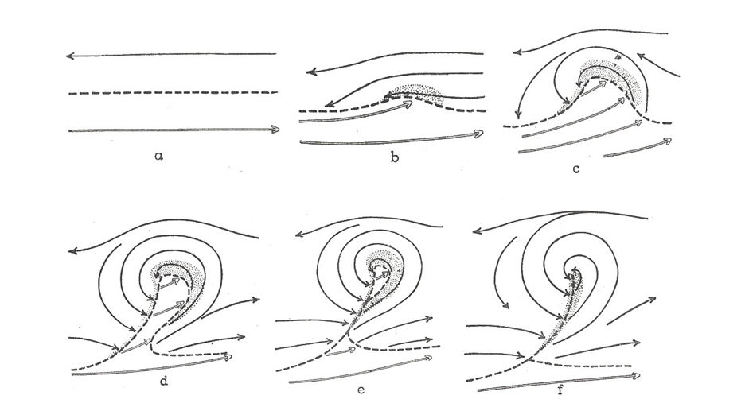
Occlusion Process
Norwegian cyclone model occlusion process – Bjerknes and Solberg 1919

Slide 68
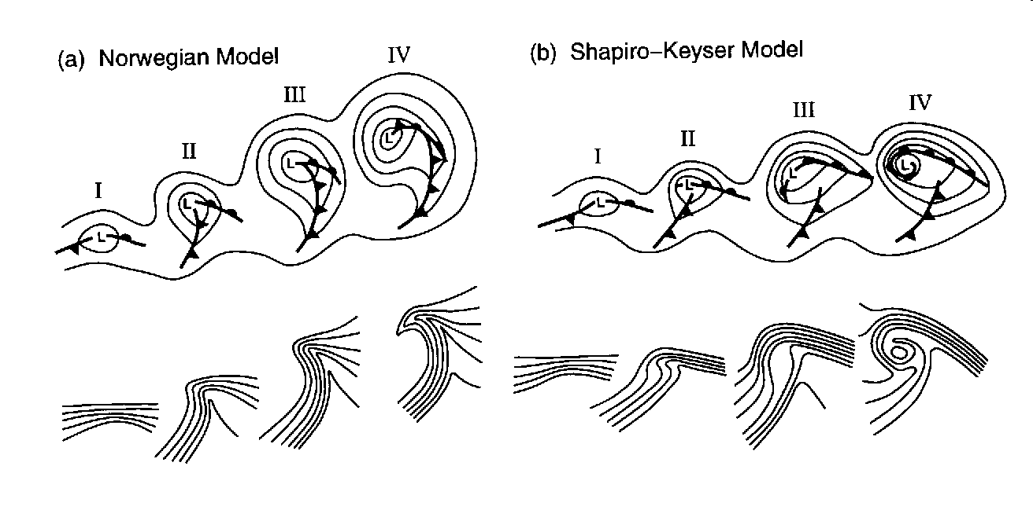
Occlusion Process
Norwegian (left) and updated Shapiro-Keyser model
http://en.wikipedia.org/wiki/File:Cyclonemodels.gif

Slide 69
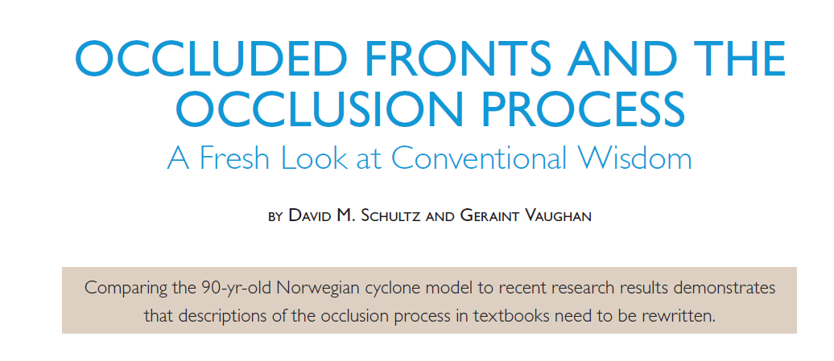

Slide 70
Schultz and Vaughan (2011, BAMS)
How do occluded fronts form?
Tenet 1: The occluded front forms and lengthens as a faster-moving cold front catches up with a slower-moving warm front

Slide 71
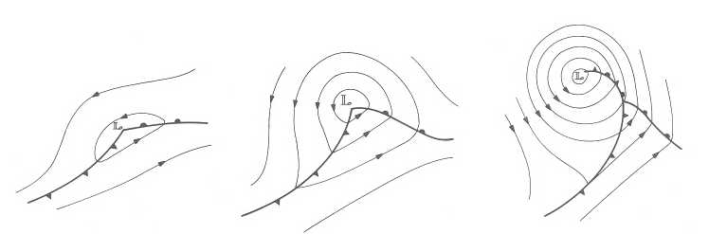
Occluded Fronts: Formation
Debate over nature of occlusion process:
Original Norwegian cyclone model: faster-moving cold front overtakes warm front
Wallace & Hobbs text: “…there are few, if any, well-documented examples of cold fronts overtaking warm fronts to form occlusions. Rather, it appears that most occluded fronts are essentially new fronts which form as surface lows separate themselves from the junctions of their respective warm and cold fronts and deepen progressively further back into the cold air.”

Slide 72
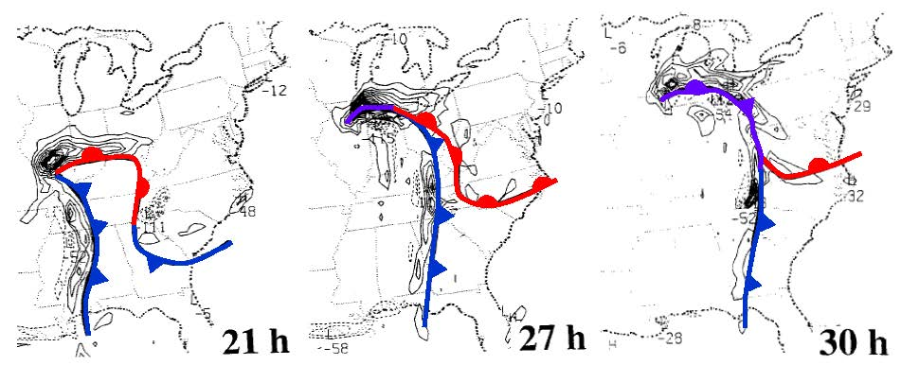
The Occlusion Process… Catch up?
Schultz and Mass (1993): Catch up mechanism CAN take place…
But… Cold-air damming may have “held back” warm front in this case

Slide 73
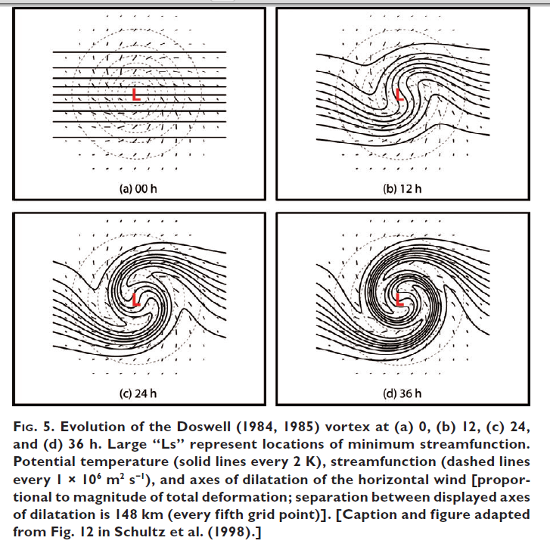
Schultz and Vaughan (2011, BAMS)
Tenet 1: The occluded front forms and lengthens as a faster-moving cold front catches up with a slower-moving warm front
TENET 1—REALITY: The occluded front forms as a result of the wrap-up of the baroclinic zone and lengthens due to flow deformation and rotation around the cyclone.

Slide 74
Schultz and Vaughan (2011, BAMS)
Are all occluded fronts the same, structurally?
TENET 2: TWO TYPES OF OCCLUSIONS ARE POSSIBLE, DEPENDING ON THE RELATIVE TEMPERATURES OF THE AIR ON EITHER SIDE OF THE OCCLUDED FRONT

Slide 75
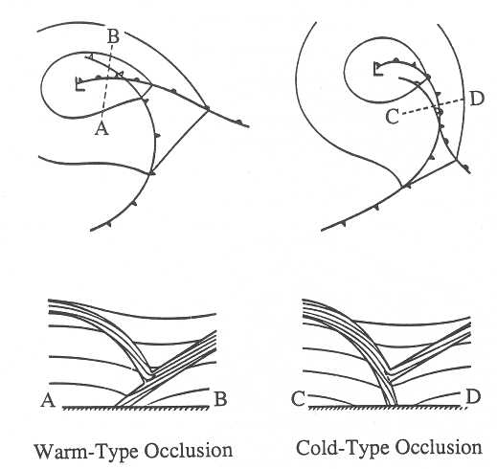
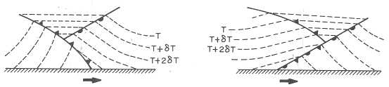
Occluded Fronts: Structure
Cold and warm-type occlusion structures (from Schultz and Mass 1993 at left, and Wallace and Hobbs 1997 below).
It is often difficult to see these classic structures in the observations…
warm
warm
cool
cold
cold
cool
warm
warm
cold
cool
cool
cold

Slide 76
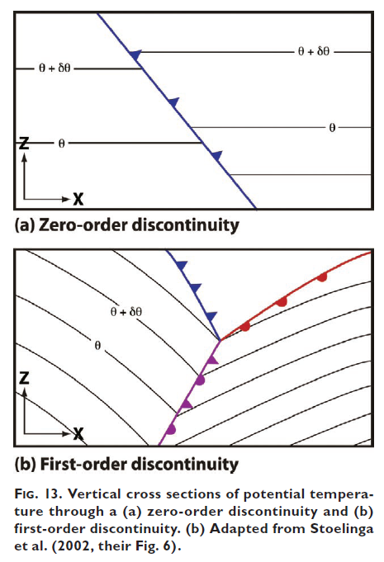
Schultz and Vaughan (2011, BAMS)
TENET 2: TWO TYPES OF OCCLUSIONS ARE POSSIBLE, DEPENDING ON THE RELATIVE TEMPERATURES OF THE AIR ON EITHER SIDE OF THE OCCLUDED FRONT
TENET 2—REALITY: Two types of occlusions are possible, depending on the relative static stabilities of the air on either side of the occluded front.
However, warm-type occlusions are more common, in general.
Stoelinga et al. 2002

Slide 77


Occluded cyclone, 06 UTC 27 Oct 2010

Slide 78

Occluded cyclone: 06 UTC 27 Oct 2010

Slide 79

Occluded cyclone: 06 UTC 27 Oct 2010

Slide 80

Occluded cyclone: 06 UTC 27 Oct 2010

Slide 81

Occluded cyclone: 06 UTC 27 October 2010
Reversed endpoints, but seems to show warm-occlusion structure

Slide 82
Schultz and Vaughan (2011, BAMS)
What is known about the strength of a cyclone at the time when occlusion takes place?
TENET 3: OCCLUSION MEANS THAT THE CYCLONE WILL STOP DEEPENING.

Slide 83


Schultz and Vaughan (2011, BAMS)
TENET 3: OCCLUSION MEANS THAT THE CYCLONE WILL STOP DEEPENING.
TENET 3—REALITY: Many cyclones continue to deepen after occlusion or never occlude at all.

Slide 84

Schultz and Vaughan (2011, BAMS)
TENET 4: OCCLUDED FRONTS ARE ASSOCIATED WITH WIDESPREAD CLOUDS AND PRECIPITATION FOLLOWED BY ABRUPT CLEARING AFTER SURFACE FRONTAL PASSAGE.
TENET 4—REALITY. Occluded fronts are associated with a variety of cloud and precipitation patterns, including dry slots and banded precipitation.

Slide 85

“Instant Occlusions”
Another non-classical frontal evolution is referred to as “instant occlusion”. This process is described by the schematic above, taken from McGinnigle et al. 1988

Slide 86

“Instant Occlusions”…
Satellite imagery is an important means of recognizing instant occlusions… January 2000 snowstorm is a great example of this. What might be the implications?

Slide 87

Instant Occlusion example: 06 UTC 24 Jan 2000

Slide 88

Instant Occlusion example: 12 UTC 24 Jan 2000
“Baroclinic leaf” pattern

Slide 89

Instant Occlusion example: 18 UTC 24 Jan 2000

Slide 90

Instant Occlusion example: 00 UTC 25 Jan 2000

Slide 91

Instant Occlusion example: 06 UTC 25 Jan 2000

Slide 92

Sea-level pressure and GOES-8 IR image 06 UTC 24 Jan 2000

Slide 93

Sea-level pressure and GOES-8 IR image 12 UTC 24 Jan 2000

Slide 94

Sea-level pressure and GOES-8 IR image 18 UTC 24 Jan 2000

Slide 95

Sea-level pressure and GOES-8 IR image 00 UTC 25 Jan 2000

Slide 96
Instant Occlusions
Rapidly evolving structure that can be associated with heavy precipitation in cold sector
Satellite signature useful to recognize approach of upper disturbance to main frontal zone
Rapid cyclogenesis can be associated with these events, as it was in Jan 2000

Slide 97
Coastal Fronts
What is a “coastal front”?
How do they form?
Why do they matter?
What type of weather is associated with them?

Slide 98
Coastal Fronts: Mechanisms
i.) Shearing: Changes frontal intensity through differential temperature advection by the front parallel component of the flow.
ii.) Confluence: Changes frontal intensity through differential temperature advection by the front-normal component of the flow.
iii.) Tilting: Changes frontal intensity through differential vertical motion
iv.) Differential diabatic heating: Includes processes such as radiation, latent heat release or absorption, and surface heat fluxes.

Slide 99
Coastal Front Formation
• Differential diabatic processes contribute directly to frontogenesis
High to north, easterly geo. flow offshore
What type of mesoscale circulation would develop?
What are the frontogenesis mechanisms here?
Warm Sea Surface
Land
dθ/dt > 0
confluence, frontogenesis, enhanced by mesoscale circulation
Land breeze
Northeasterly synoptic-scale geostrophic flow
Land – cooler than ocean

Slide 100
Coastal Front Formation
Cold-air damming
2°C
6°C
-4°C
0°C
4°C
8°C
-2°C
-2°C
10°C
1012 mb
Appalachian Mountains
12°C
1008 mb
14°C
• Ageostrophic cold advection west of coastal zone: shearing frontogenesis
• CAD favors coastal frontogenesis
• Differential friction can also play a role, enhancing convergence/confluence at coast
1004 mb
What mechanisms here?

Slide 101
Mechanisms of Frontogenesis: Which are likely to be important during (surface) coastal front formation?
Yes
i.) Shearing?
ii.) Confluence?
iii.) Tilting?
iv.) Differential diabatic heating?
Yes
No
Yes
Notes:
2

Slide 102


Coastal Front Examples

Slide 103

Sea-surface Temperature

Slide 104

How does Sensible Weather Evolve as Coastal Front Passes?

Slide 105

Sensible Weather with Coastal Front Passage

Slide 106

Onshore Composite SLP
Offshore Composite SLP

Slide 107
Coastal Fronts
Understanding the physical processes that lead to the development of the coastal front
Confluence between offshore synoptic flow, land-breeze and frictionally deflected flow over land
Shearing frontogenesis, especially with CAD to west
Differential diabatic heating
Gain an understanding of the impacts that coastal fronts can have on local weather conditions
Structure, weather evolution similar to a warm front

Slide 108
Coastal Fronts⎯Characteristics
• Shallow, mesoscale front separating cold, continental air from warm maritime air
• Most common during cold season (November through March), and along concave coastlines (e.g., New England, Carolinas, Texas)
• Quasistationary or warm-frontal in character, may migrate inland (forecasting challenge)
• “Miniature warm front-type” structure (Riordan, Raman studies)
• Heaviest precipitation on cold side of front
• Often forms eastern boundary of CAD cold dome
• “Inverted trough” often accompanies coastal front
• May serve as site of primary or secondary cyclogenesis (remember vorticity equation arguments!)
• Can be accompanied by convection, even severe weather

Slide 109

Example, 24 Nov. 2007

Slide 110

Example, 24 Nov 2007

Slide 111

Example, 24 Nov 2007

Slide 112

Example, 24 Nov 2007

Slide 113

Example, 25 Nov. 2007

Slide 114

Example, 25 Nov 2007

Slide 115

Example, 25 Nov 2007

Slide 116

Example, 25 Nov 2007

Slide 117

Example, 25 Nov 2007

Slide 118

Example, 25 Nov 2007

Slide 119

Example, 25 Nov 2007

Slide 120

Example, 25 Nov 2007

Slide 121

Example, 26 Nov 2007

Slide 122

Example, 26 Nov 2007

Slide 123

Example, 26 Nov 2007

Slide 124

Example, 26 Nov 2007

Slide 125

Example, 26 Nov 2007

Slide 126

Example, 26 Nov 2007

Slide 127

Example, 26 Nov 2007

Slide 128

Example, 26 Nov 2007

Slide 129

Example, 27 Nov 2007

Slide 130

Example, 27 Nov 2007

Slide 131

Example, 27 Nov 2007

Slide 132

Example, 27 Nov 2007

Slide 133
MEA 443 Course Outline
6. Fronts
6.1. What is a Front?
6.2. Kinematic Frontogenesis
6.3. Dynamic Frontogenesis
6.4. Types of Frontal Systems
6.5. Middle- and Upper-Level Fronts
Notes:
2

Slide 134
Fronts: Objectives
The objectives of this section are to:
Review the basic properties and importance of fronts
Develop physical understanding of mechanisms of frontogenesis
Examine frontal structures, understand mechanisms responsible
Review mechanism of upper-level frontogenesis & tropopause folds
Develop/improve ability to predict frontal weather

Slide 135

Observational Analysis: Upper Front (Shapiro, 1981)
Left: isentropes (solid), isotachs (dashed, m/s). Right: Potential vorticity (solid)

Slide 136

Modeling Results: Upper Front (Keyser et al. 1986)

Slide 137


Observational Analysis: Upper Front (Lackmann et al. 1997)

Slide 138

Upper Front (18 UTC 25 Aug 2004) PV (shaded), isentropes (black), isotachs (red)

